Slide 1
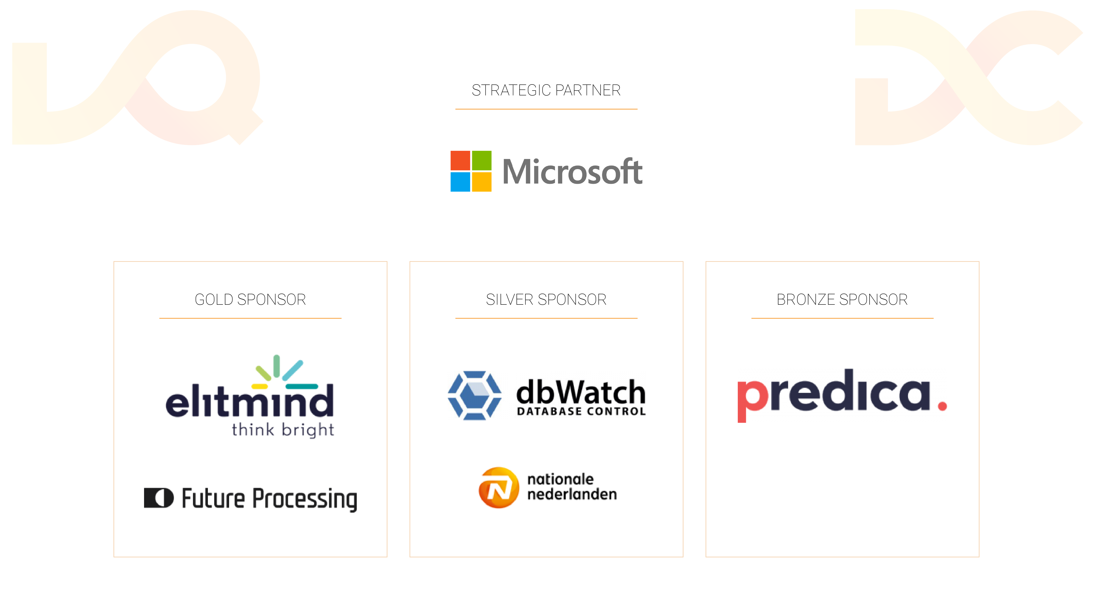

Slide 2
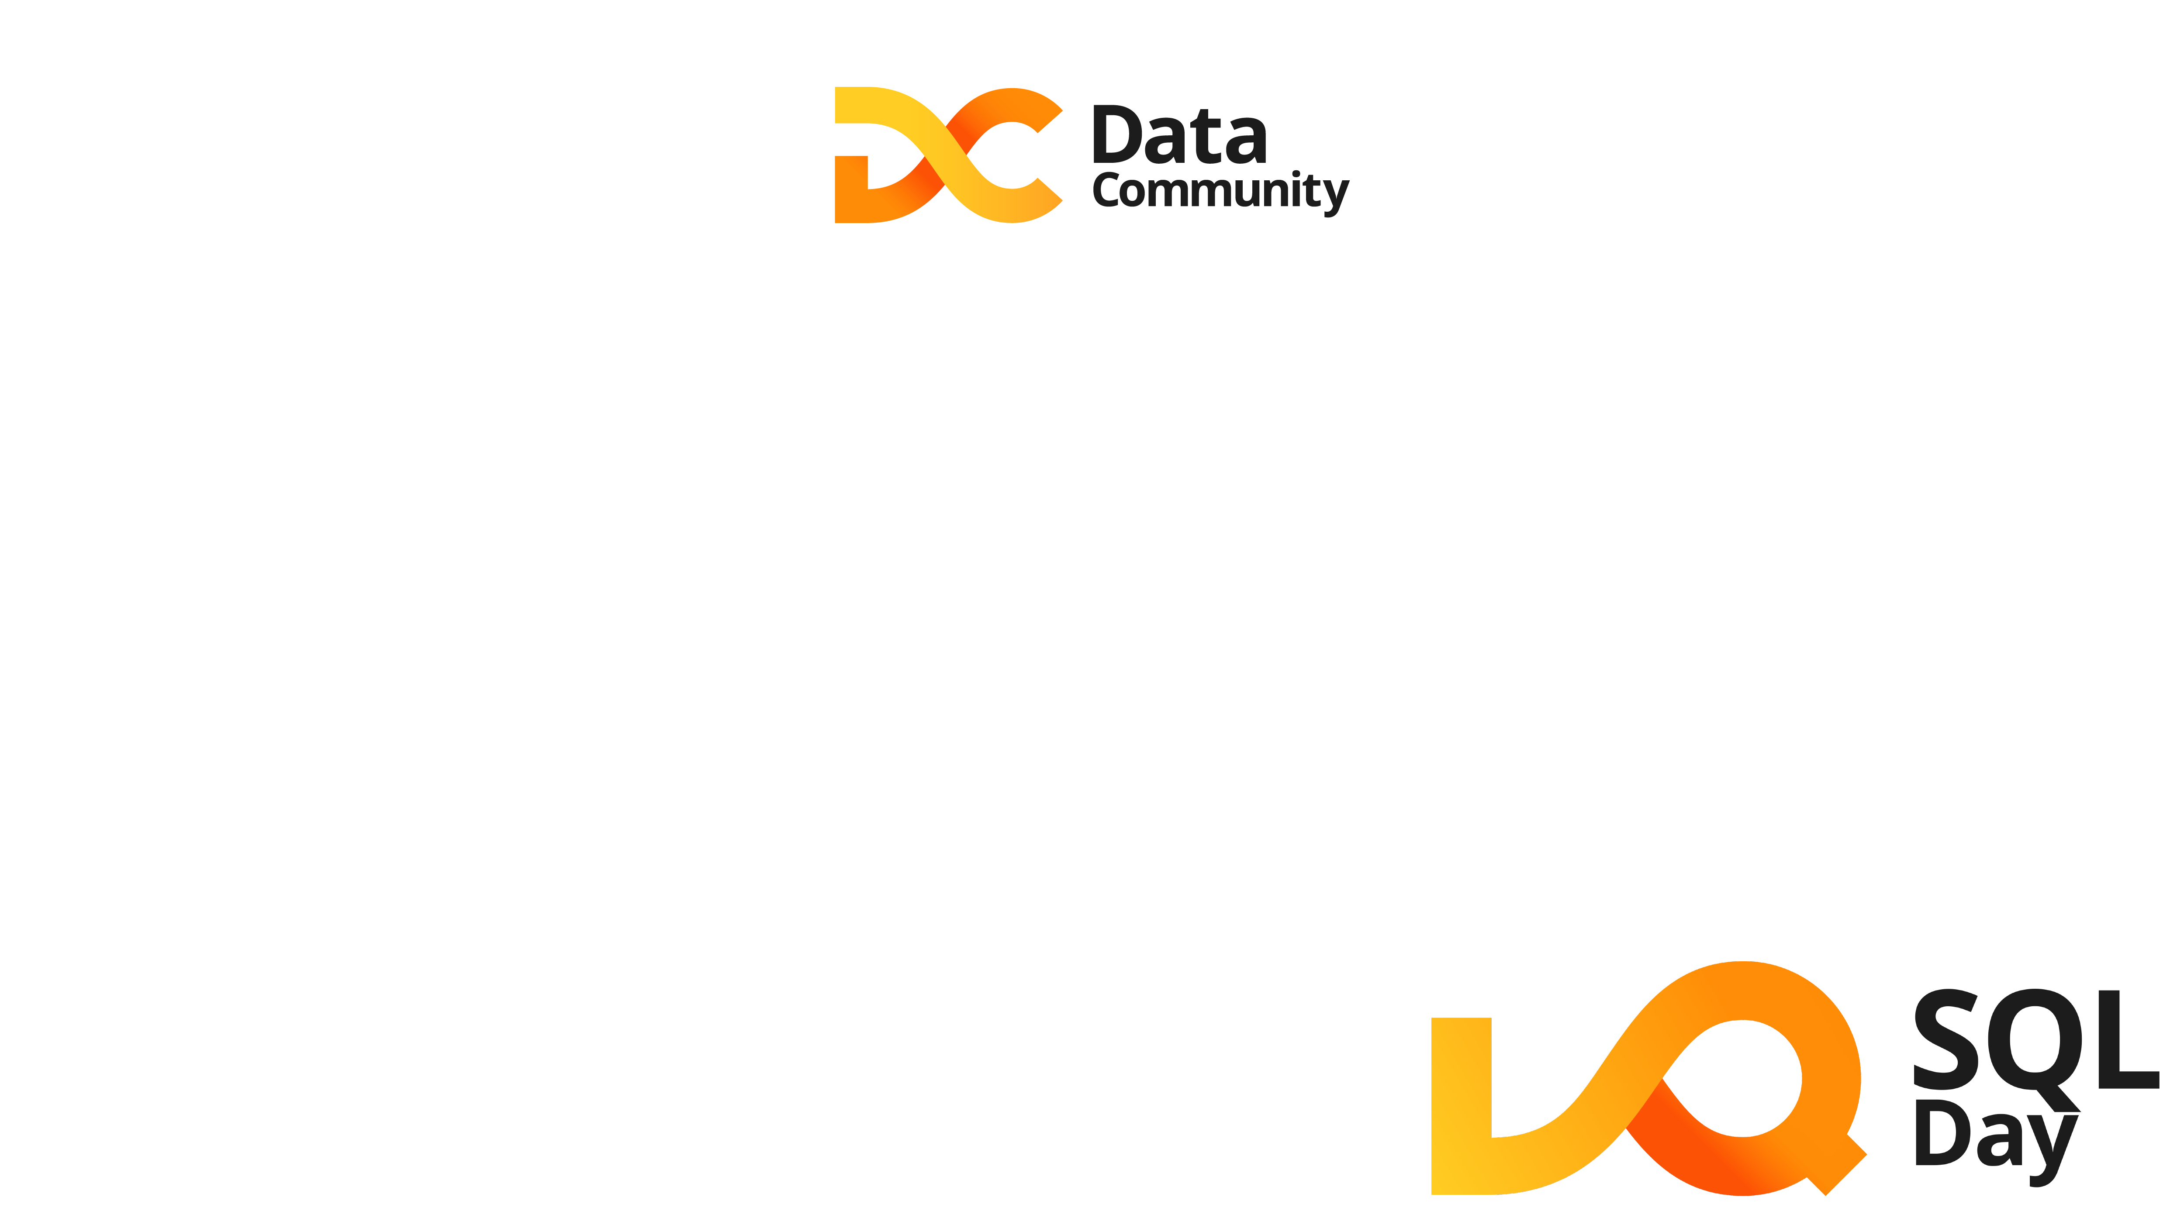
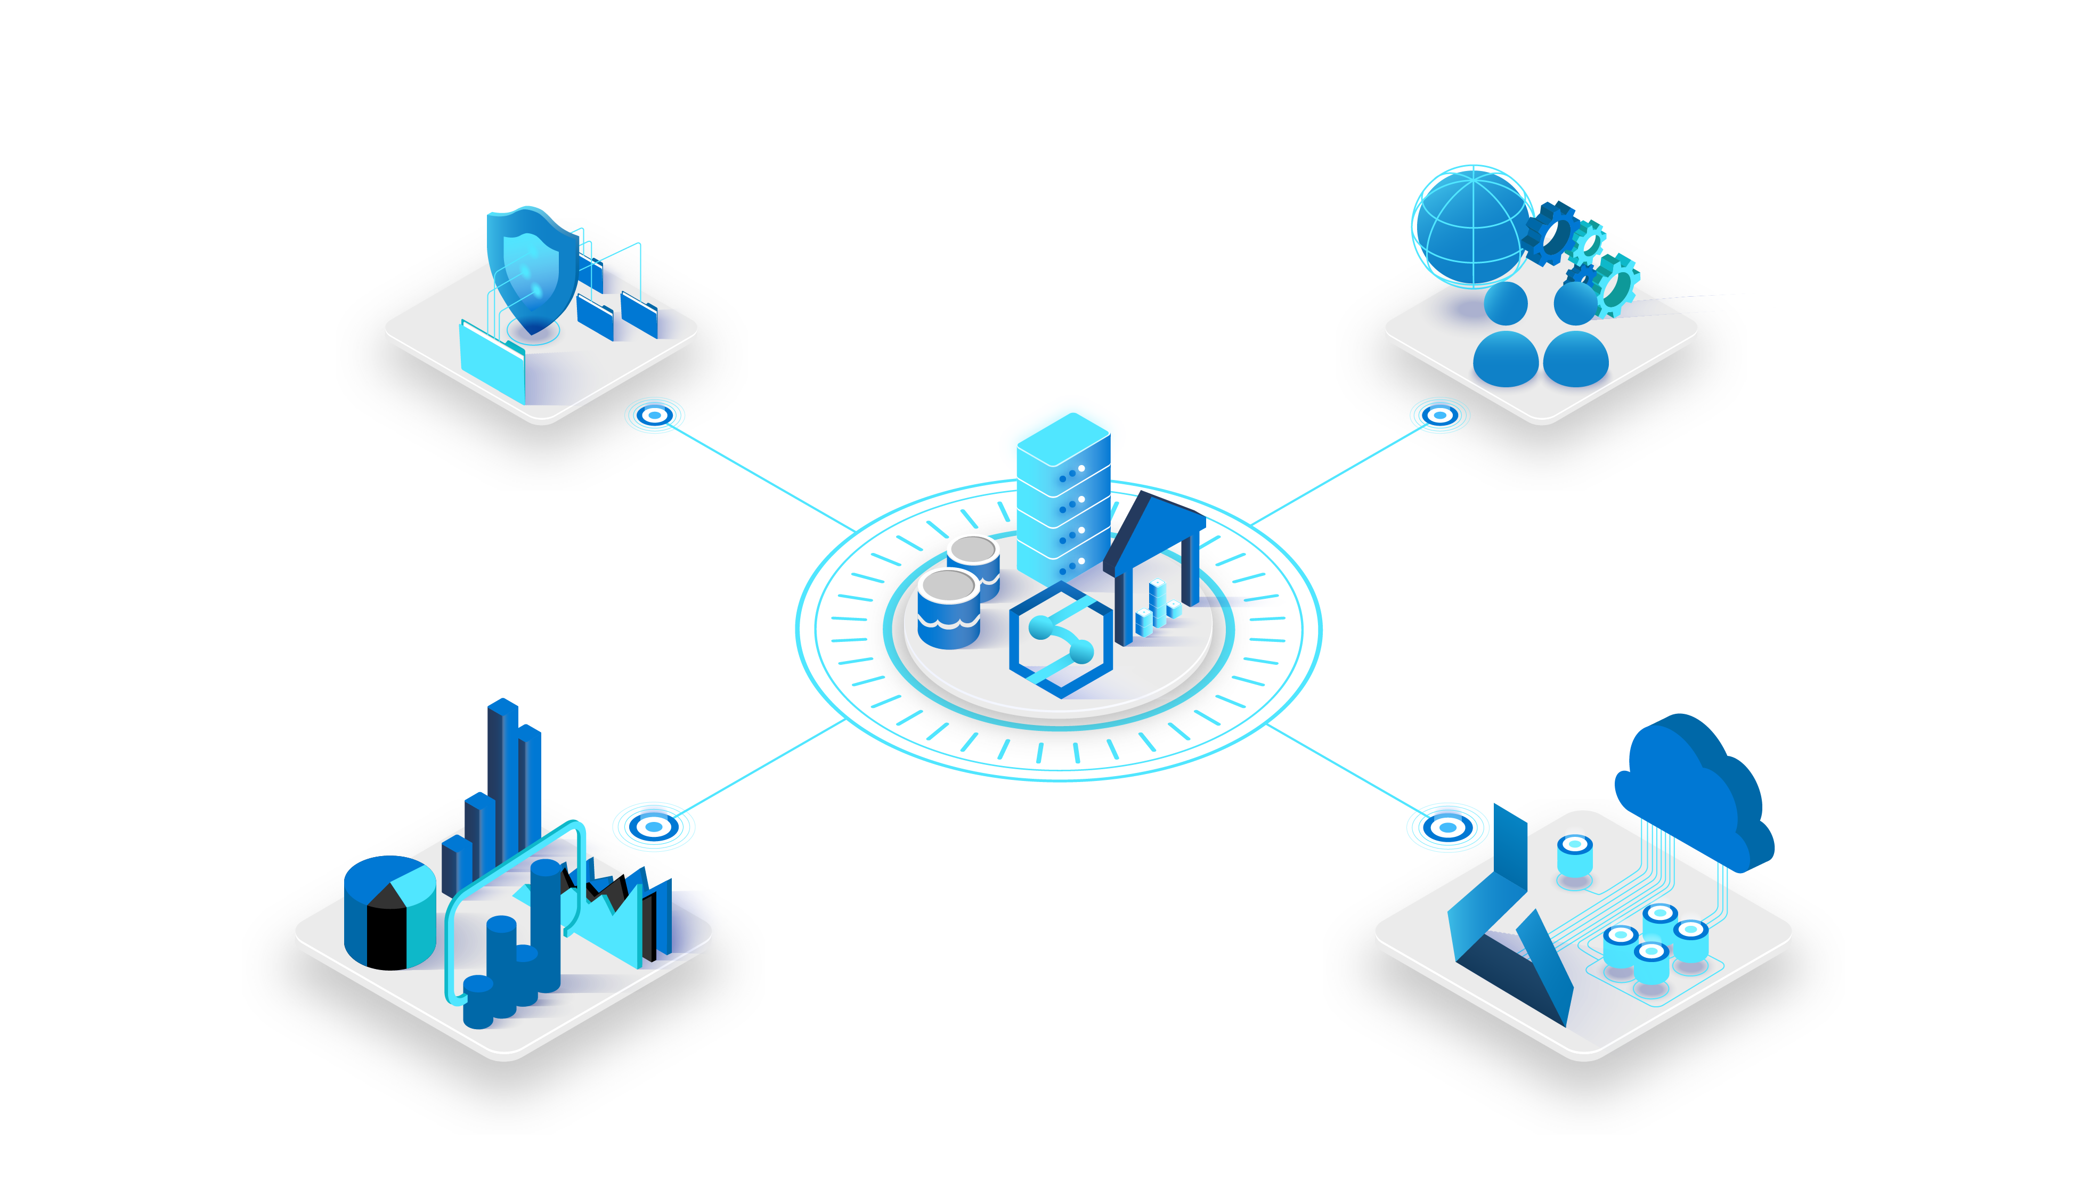
Modern Data Warehouse in Azure Why, How, What
Paweł Potasiński | pawel.potasinski@elitmind.com

Slide 3




About Speaker
HoCT @ Elitmind
Founder of PLSSUG (now DC.pl)
Microsoft MVP
Strong SQL/DWH/BI background
Fan of automation and smart work

Slide 4


Agenda
Analytics in the Cloud
Modern Data Warehouse - Architecture Pattern
Storage / Data Lake
Data Warehouse
Data Ingestion & Transformations
Business Models & BI Tools
Advanced Analytics
Summary

Slide 5

Analytics in the Cloud

Slide 6
Challenges of Analytics
The Era of Data
Agility Required
Standardization
Work with data using well-known industry standards (availability of competences on the market)
Volumes, variety and velocity of data
Progressive democratization of data
The need for real-time analytics
New business models based on data
Too many manual processes
Costs too high compared to the actual use of the IT infrastructure
Business waiting too long for insights
Weak integration of analytical solutions with existing systems
Proactive security in the age of cyber-crime, in accordance with standards and regulations
High availability of solutions (high SLA)
Data literacy as a new business skill

Slide 7
Types of Analytics
How can we
make it happen?
What will
happen?
Prescriptive
Analytics
Why did it
happen?
Predictive
Analytics
What
happened?
Optimization
Value
Diagnostic
Analytics
Descriptive
Analytics
Information
Difficulty

Slide 8
Types of Analytics
How can we
make it happen?
What will
happen?
Prescriptive
Analytics
Why did it
happen?
Predictive
Analytics
What
happened?
Optimization
Value
Diagnostic
Analytics
Descriptive
Analytics
Information
Difficulty

Slide 9
Types of Analytics
Traditional DW
How can we
make it happen?
What will
happen?
Prescriptive
Analytics
Why did it
happen?
Predictive
Analytics
What
happened?
Optimization
Value
Diagnostic
Analytics
Descriptive
Analytics
Information
Difficulty

Slide 10
Types of Analytics
Modern DW
Traditional DW
How can we
make it happen?
What will
happen?
Prescriptive
Analytics
Why did it
happen?
Predictive
Analytics
What
happened?
Optimization
Value
Diagnostic
Analytics
Descriptive
Analytics
Information
Difficulty

Slide 11
Traditional Data Warehousing
SOURCES
ETL
WAREHOUSE
DATA MARTS
Data
Mart
Transform
Extract
Load
Refresh
Data
Mart
STG
cube

Slide 12
Why Analytics in the Cloud?
Elasticity and scalability of the cloud => cost optimization
Traditional IT
Cloud deployment
3
Hardware purchases needed
2
Demand forecast
Capacity
Shortage
IT capacity
Actual usage
1
Wasted capacity
Cloud capacity
Capacity
Time
Get resources when you need them, pay only when you use them

Slide 13
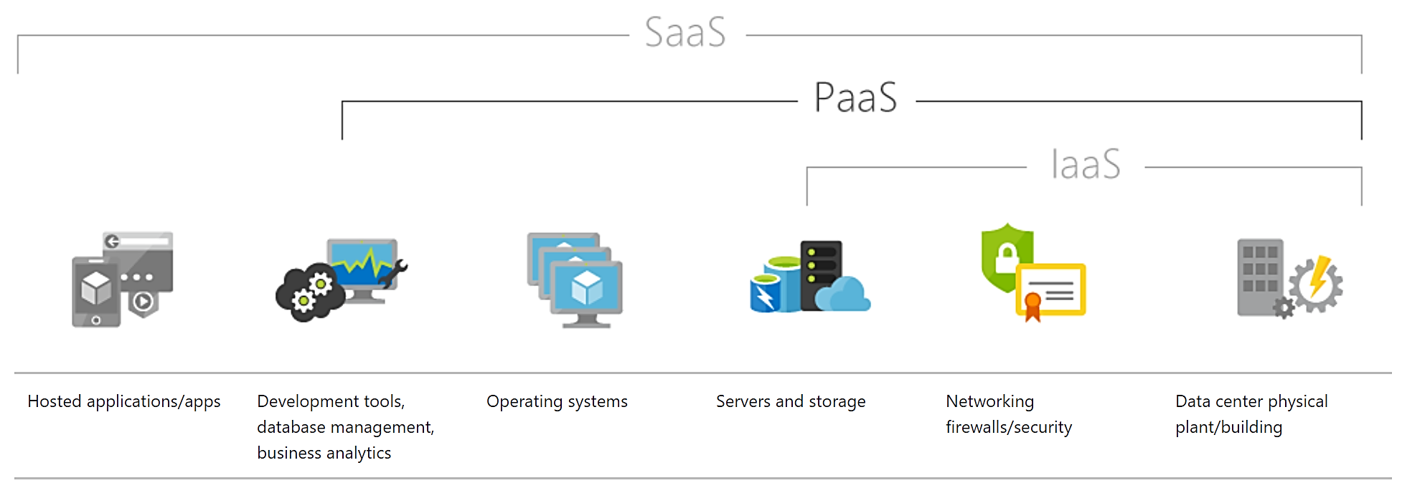
Cloud Deployment Models
Components maintained by cloud vendor
https://azure.microsoft.com/en-us/overview/what-is-paas/

Slide 14
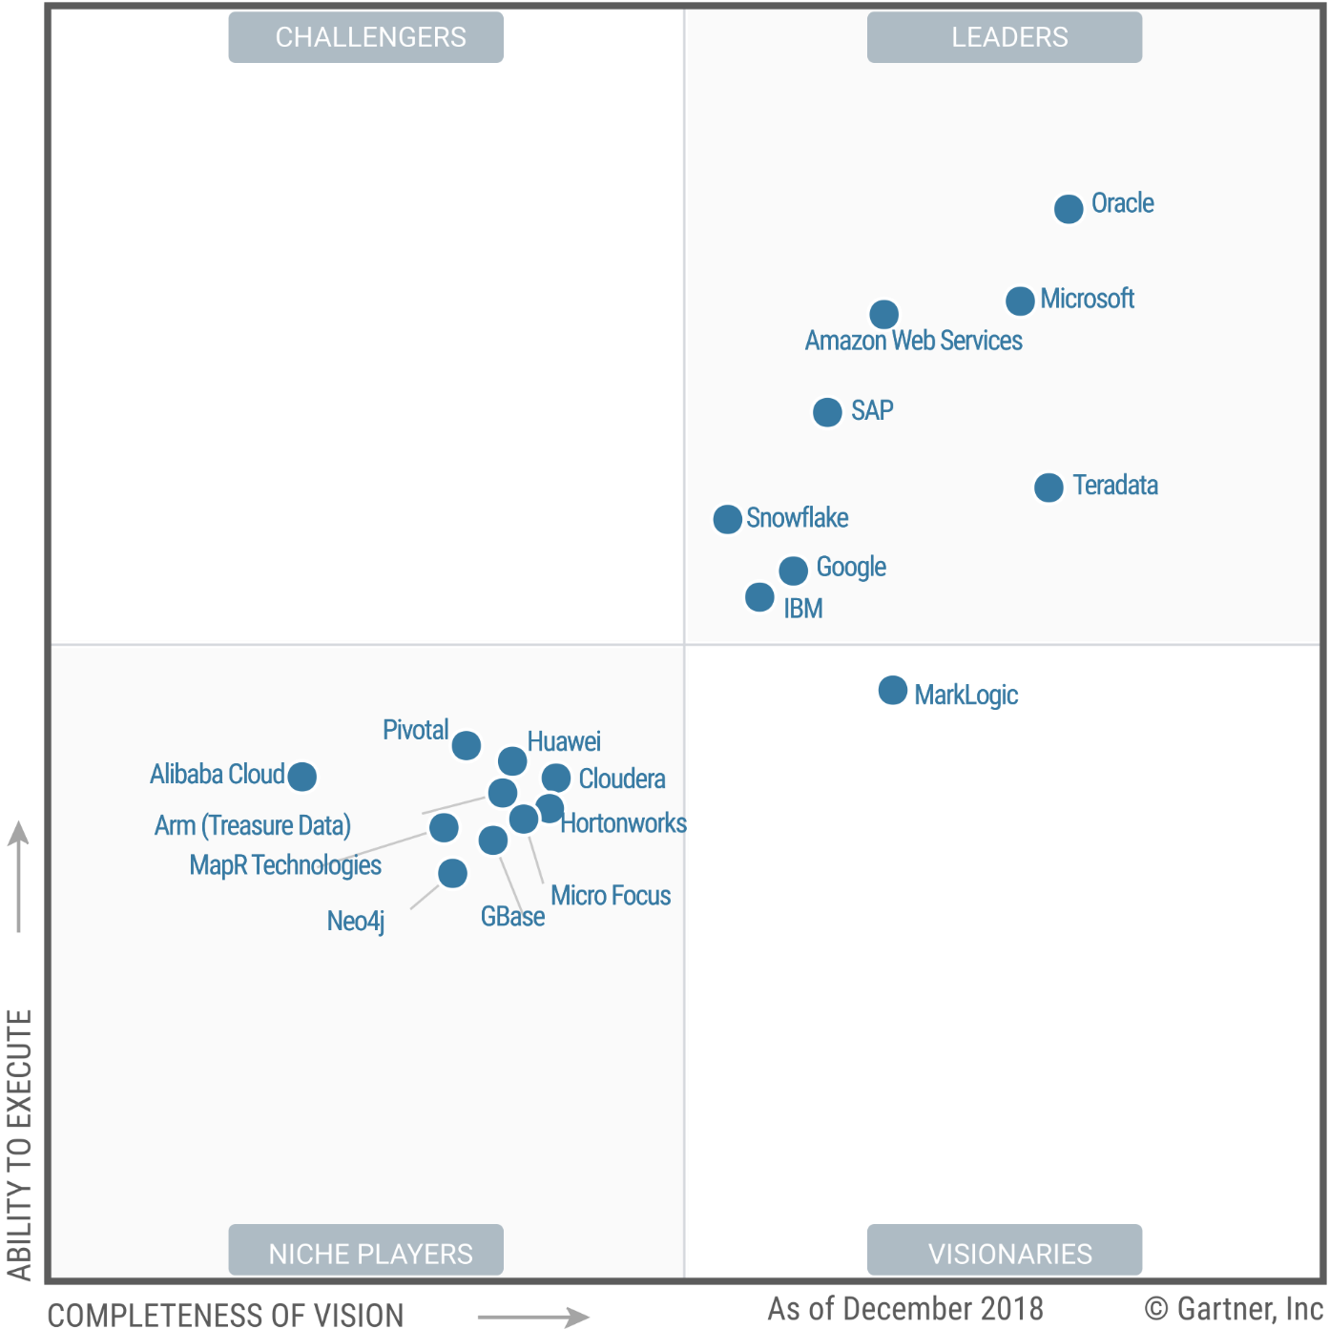
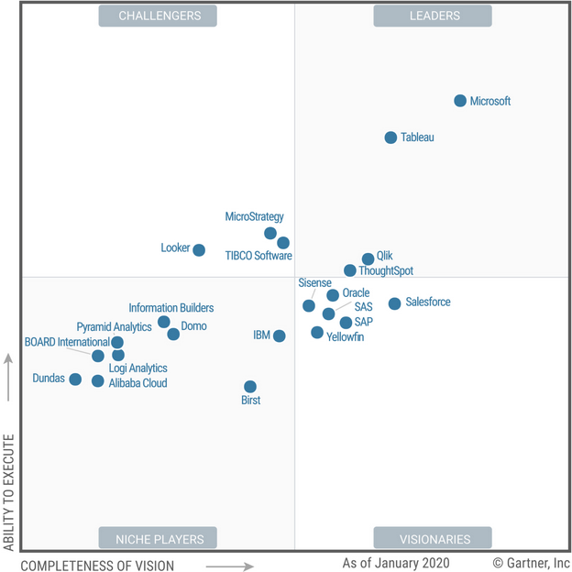
Microsoft Named a Leader in Analytics
Data Management Platforms for Analytics
Analytics and Business Intelligence Platforms

Slide 15
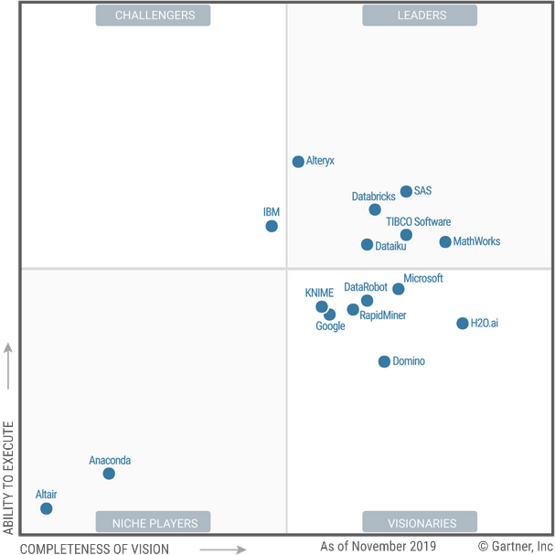
Data Science and Machine Learning Platforms
Databricks named a leader and can be used as a first-party in Azure.

Slide 16
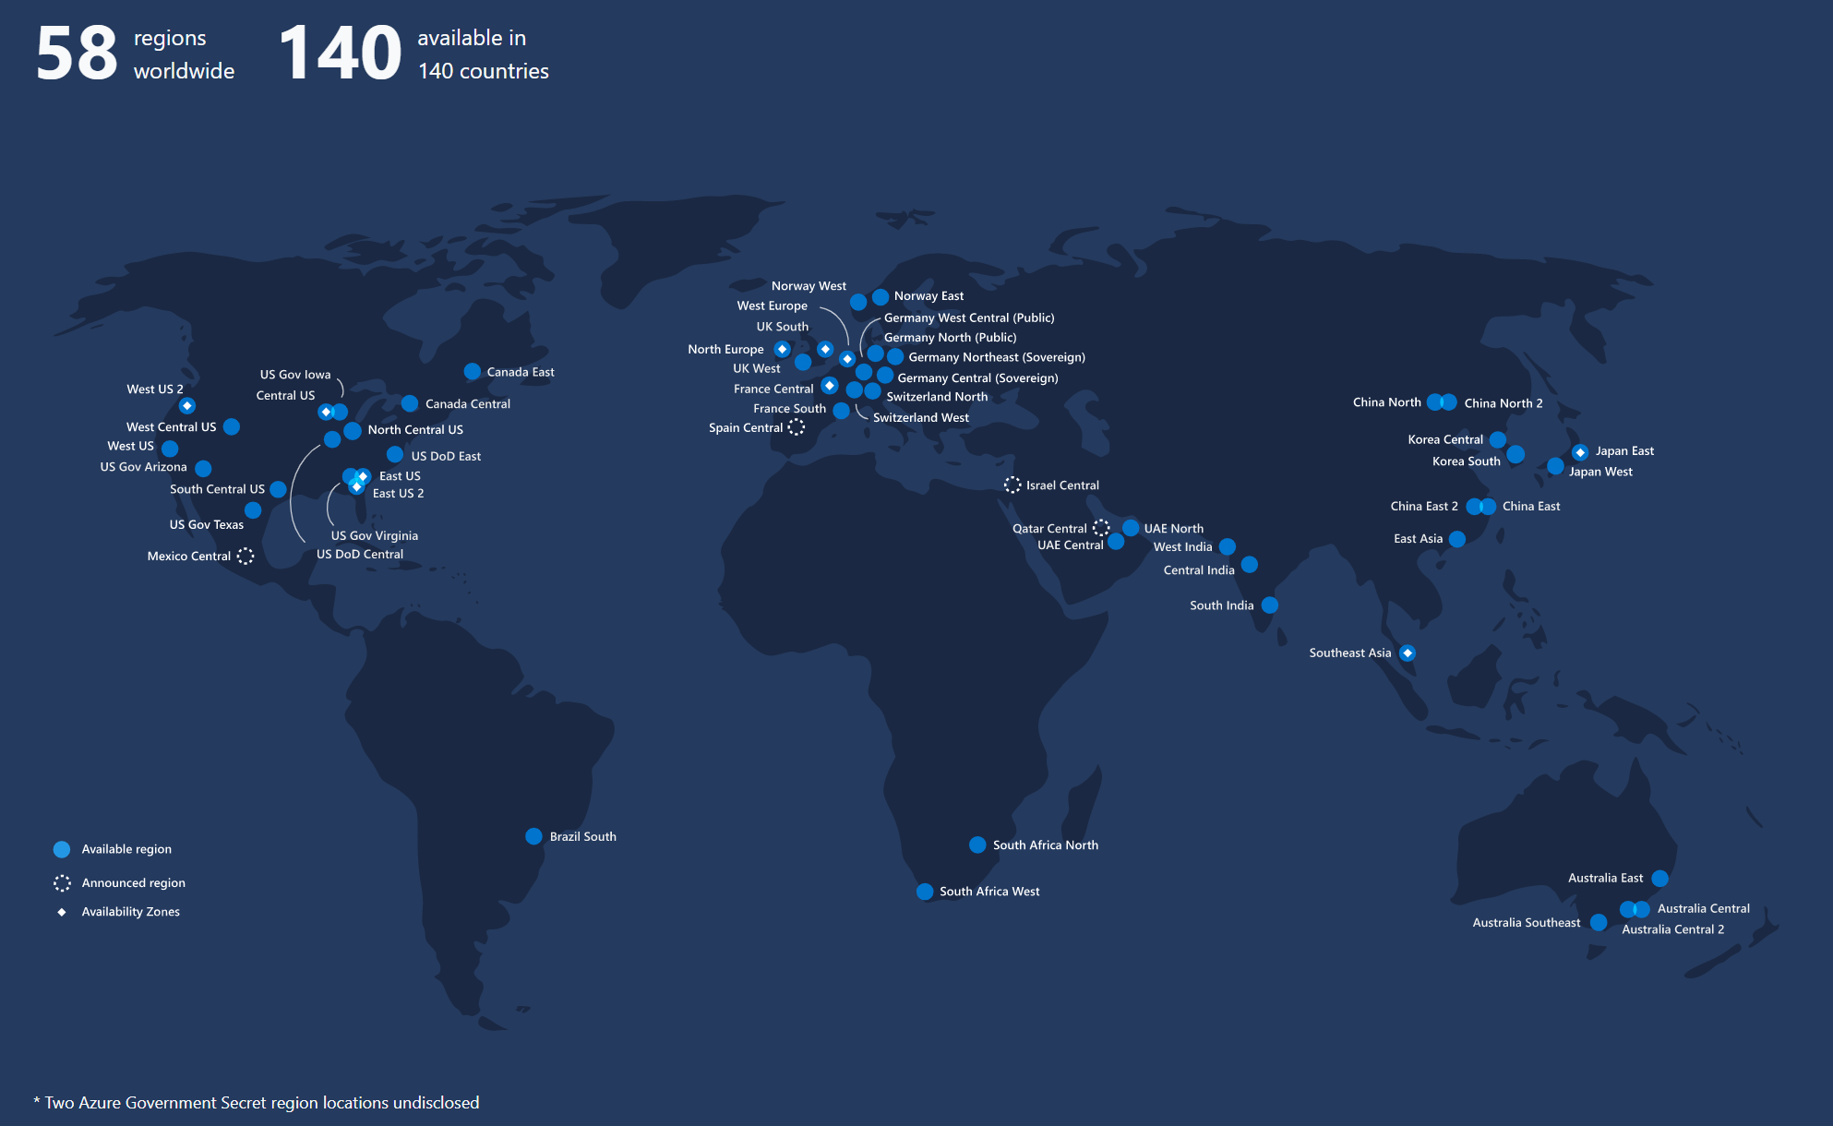


Slide 17

Modern Data Warehouse - Architecture Pattern

Slide 18

Architecture Pattern
LOB sources
Azure Data Factory
Business services
Azure Synapse Analytics
Logs and streams (unstructured)
Azure Databricks
Power BI
Media (unstructured)
Files (unstructured)
Azure Data Lake Storage

Slide 19
Data Sources
LOB sources
Azure Data Factory
Business services
Azure Synapse Analytics
Logs and streams (unstructured)
Azure Databricks
Power BI
Media (unstructured)
Files (unstructured)
Azure Data Lake Storage

Slide 20
Data Ingestion & Transformations
LOB sources
Azure Data Factory
Business services
Azure Synapse Analytics
Logs and streams (unstructured)
Azure Databricks
Power BI
Media (unstructured)
Files (unstructured)
Azure Data Lake Storage

Slide 21
Data Lake and Data Warehouse
LOB sources
Azure Data Factory
Business services
Azure Synapse Analytics
Logs and streams (unstructured)
Azure Databricks
Power BI
Media (unstructured)
Files (unstructured)
Azure Data Lake Storage

Slide 22
Business Models and BI Tools
LOB sources
Azure Data Factory
Business services
Azure Synapse Analytics
Logs and streams (unstructured)
Azure Databricks
Power BI
Media (unstructured)
Files (unstructured)
Azure Data Lake Storage

Slide 23
The Glossary
Data Sources – operational systems, files, databases, both on-premises and in the cloud
ELT – Extract, Load, Transform – data ingestion process preferred in the cloud
Data Lake – a well-organized storage for huge volume of data of any kind (structured, unstructured, semi-structured)
Data Warehouse – a well-defined and organized relational database built for analytics on top of integrated data from multiple data sources
Business Model – a data model presented to the end users and BI tools
Business Intelligence Tools – tools used to turn data into insights using data visualuzation techniques
Advanced Analytics – tools for running analytical experiments, advanced data preparation, machine learning model training and serving

Slide 24

Storage – Data Lake

Slide 25
Architecture Pattern
LOB sources
Azure Data Factory
Business services
Azure Synapse Analytics
Logs and streams (unstructured)
Azure Databricks
Power BI
Media (unstructured)
Files (unstructured)
Azure Data Lake Storage

Slide 26
Data Lake
LOB sources
Azure Data Factory
Business services
Azure Synapse Analytics
Logs and streams (unstructured)
Azure Databricks
Power BI
Media (unstructured)
Files (unstructured)
Azure Data Lake Storage

Slide 27

Data Lake Pros
Storage is the landing zone for data in the cloud
Same story for all major clouds (AWS, Azure, GCP)
It’s cheap and can be cheaper using access tiers
It’s redundant (HDFS nature + geo-replication features)
It’s great for fast analytics (load & analyze)
It can provide performance (compressed data formats)
Often offers the most efficient way to load data into data warehouse
Data can be easily consumed by modern BI tools

Slide 28

Storage Options in Azure
Azure Blob Storage
Object-based storage manages data as discrete units
Flat namespace for files (no folders)
Folders are part of the URI, but they’re merely simulated
No folder level security
No folder-specific performance optimizations
Hot/cold/archive tiers
Azure Data Lake Storage Gen2
Hierarchical namespace
Fine-grained security via ACLs
Hadoop and big data optimizations
Parallelized reads and writes
Scaled-out over multiple nodes
Hot/cold/archive tiers
Azure Storage + settings

Slide 29
Storage Redundancy Options
Zone 1
Zone 2
Zone 3
Async
Primary
Secondary
Async
Primary
Secondary
LRS
(Locally Redundant Storage)
ZRS
(Zone Redundant Storage)
GRS
(Geo Redundant Storage)
RA-GRS
(Read Access – Geo Redundant Storage)
3 replicas, 1 region
3 replicas across 3 Zones
6 replicas, 2 regions (3/region)
GRS + Read access to secondary

Slide 30
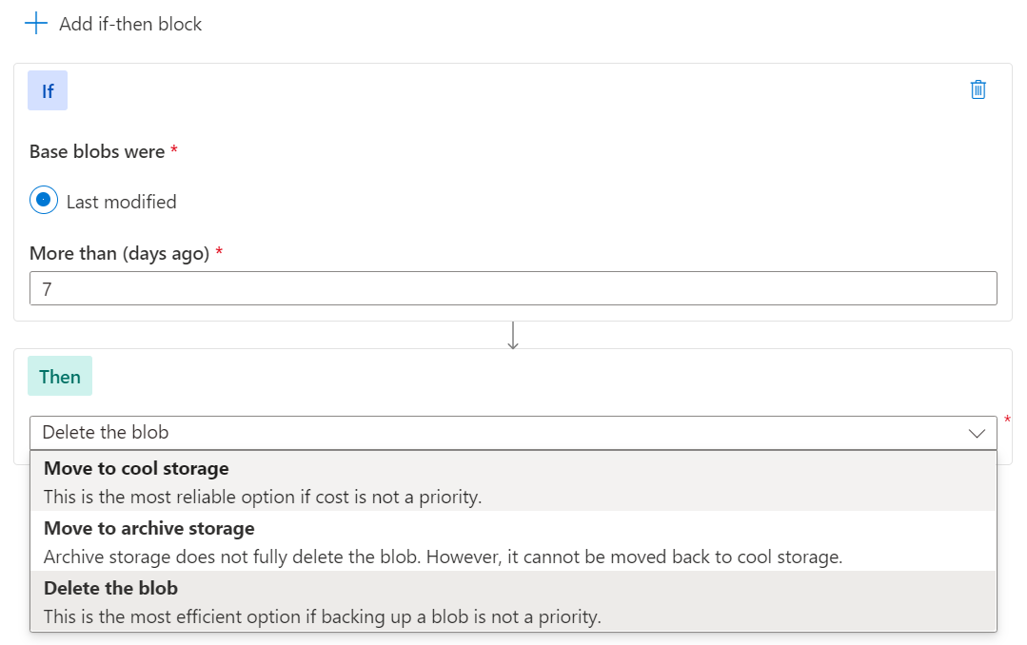
Blob Level Tiering and Lifecycle
Blob REST API
Hot Tier
Lower Transaction cost
Cool Tier
Lower Capacity cost
Archive Tier
Lowest Capacity cost
Blob-Level Tiering

Slide 31
Data Lake Zones
LOB sources
Azure Data Factory
Business services
Azure Synapse Analytics
Logs and streams (unstructured)
Azure Databricks
Power BI
Media (unstructured)
RAW
TRANSIENT
ARCHIVE DATA
Files (unstructured)
DROP
MASTER DATA
SENSITIVE DATA
CURATED DATA
STANDARDIZED DATA
STAGED DATA
ANALYTICS SANDBOX
Azure Data Lake Storage

Slide 32
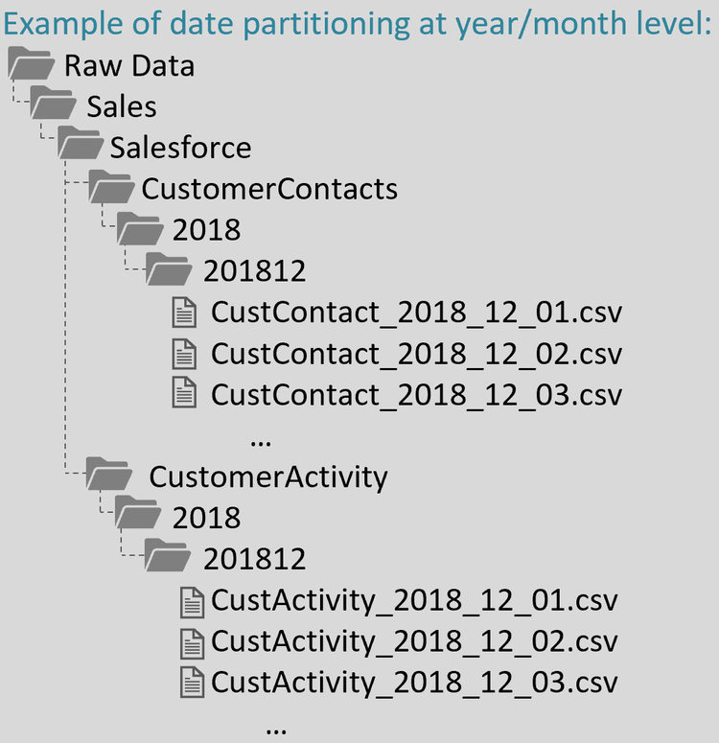
Data Lake Organization
Keep it consistent to avoid swamp!
Data Lake Zone (RAW/STAGE/...)
Business Area (Sales/Logistics/...)
Data Source (ERP/CRM/...)
Data Entity (Customers / ...)
Year (2019 / year=2019)
Month (201901 / ...)
Day (20190101 / ...)

Slide 33

Principles for Data Lake Zones
Data Lake is NOT just a storage
Data Lake requires careful planning
Zones
Hierarchies
Naming conventions
File formats
Data access patterns
Keep consistency for everything
Put as much automation in the data lake as possible
Limit user access to data lake (max. 32 ACLs per file or folder)
Have processess in place
Define the rules and tools for moving data among different zones in data lake
Plan and implement access policies
Consider data/zone ownership
Collect metadata if possible (link to some idea)
Make optimizations possible by allowing data pruning (use partitioning) and planning data lifecycle
AVOID DATA SWAMP

Slide 34
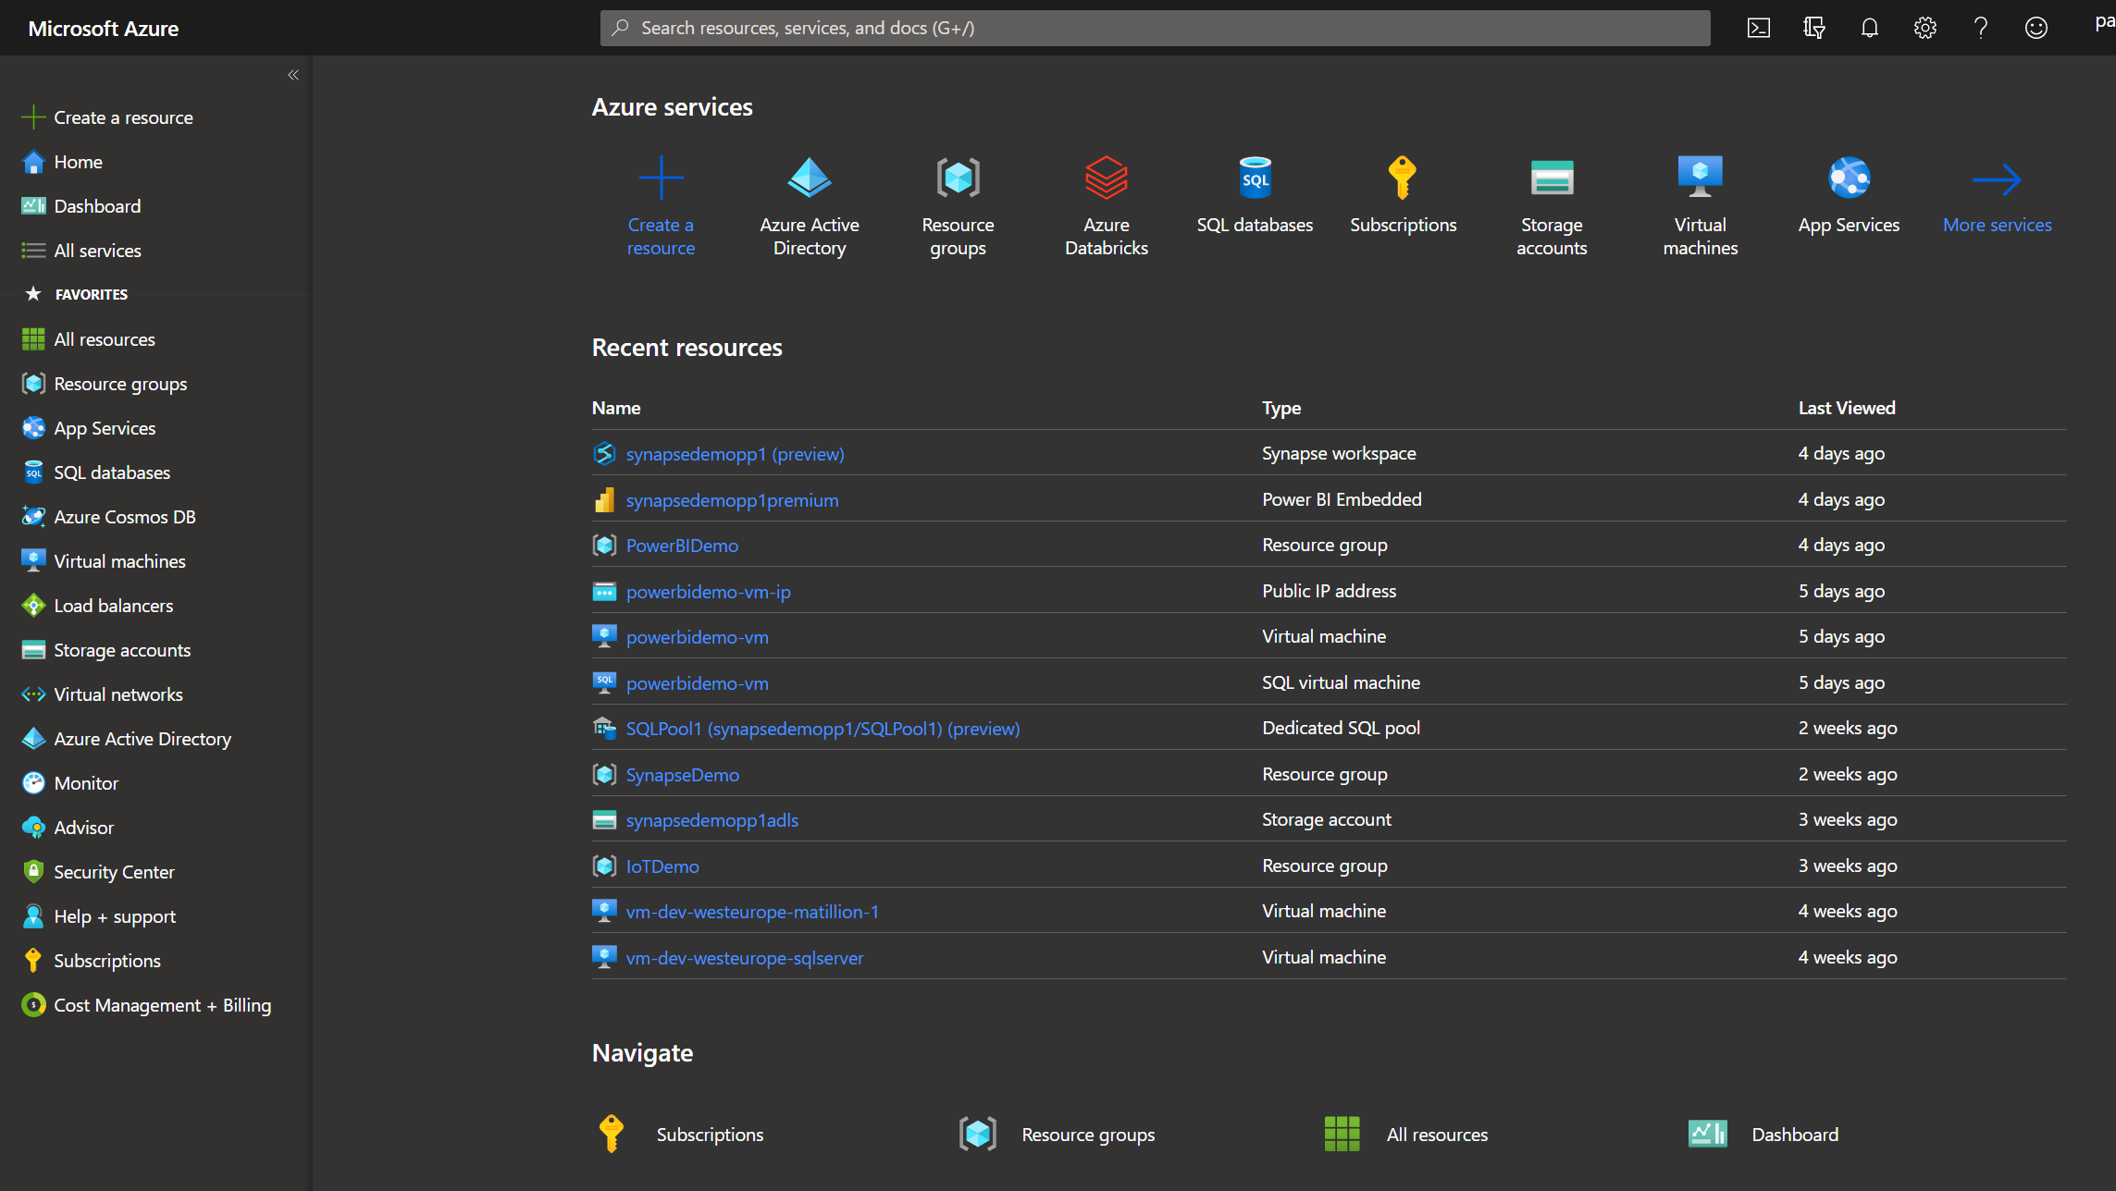
Demo
Working with Data Lake

Slide 35

Modern Data Warehouse

Slide 36
Architecture Pattern
LOB sources
Azure Data Factory
Business services
Azure Synapse Analytics
Logs and streams (unstructured)
Azure Databricks
Power BI
Media (unstructured)
Files (unstructured)
Azure Data Lake Storage

Slide 37
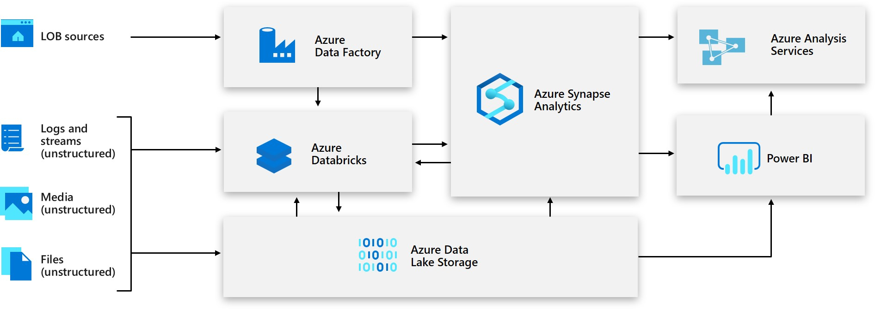
Modern Data Warehouse
Azure Synapse Analytics

Slide 38
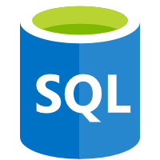

Options for Data Warehouse in Azure
Multiple „database” options
Azure Synapse Analytics (ex-SQL Data Warehouse)
Azure SQL Database
SQL Server 2019 on VM (incl. Big Data Clusters)
Third party data platforms (e.g. Snowflake)
Multiple „Big Data” options
Azure Databricks
Azure HDInsight
Hadoop or Spark on VMs

Slide 39
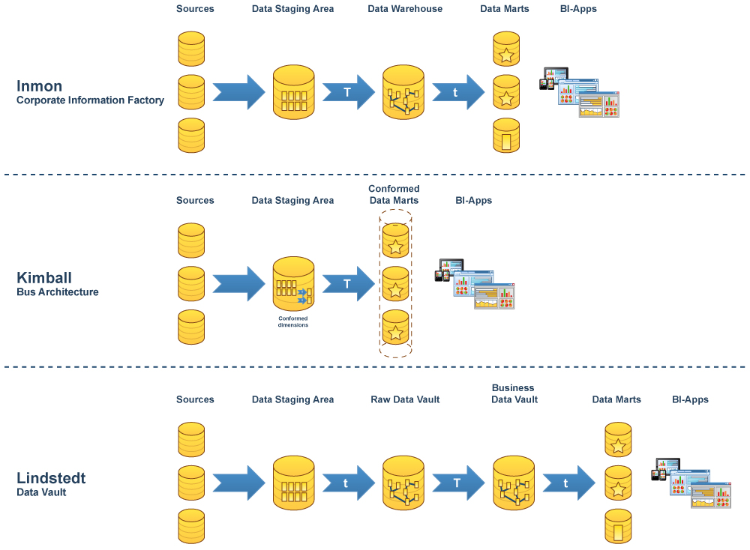
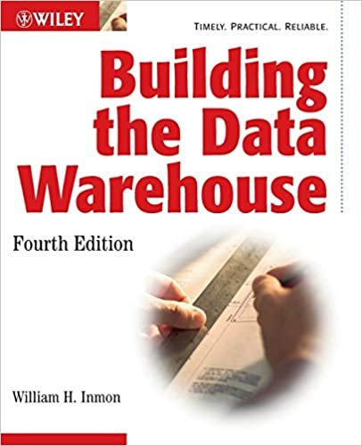
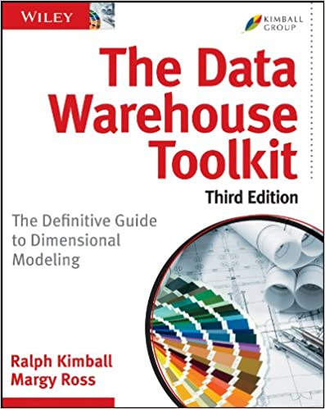
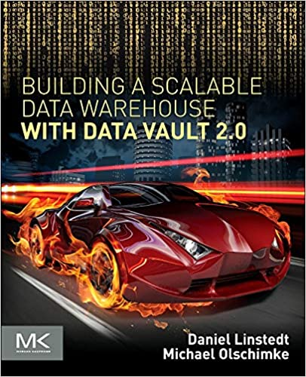
Data Warehouse Methodologies / Modelling
https://fabiofialho.com.br/wp-content/uploads/2017/09/dwh-bi-models.jpg

Slide 40
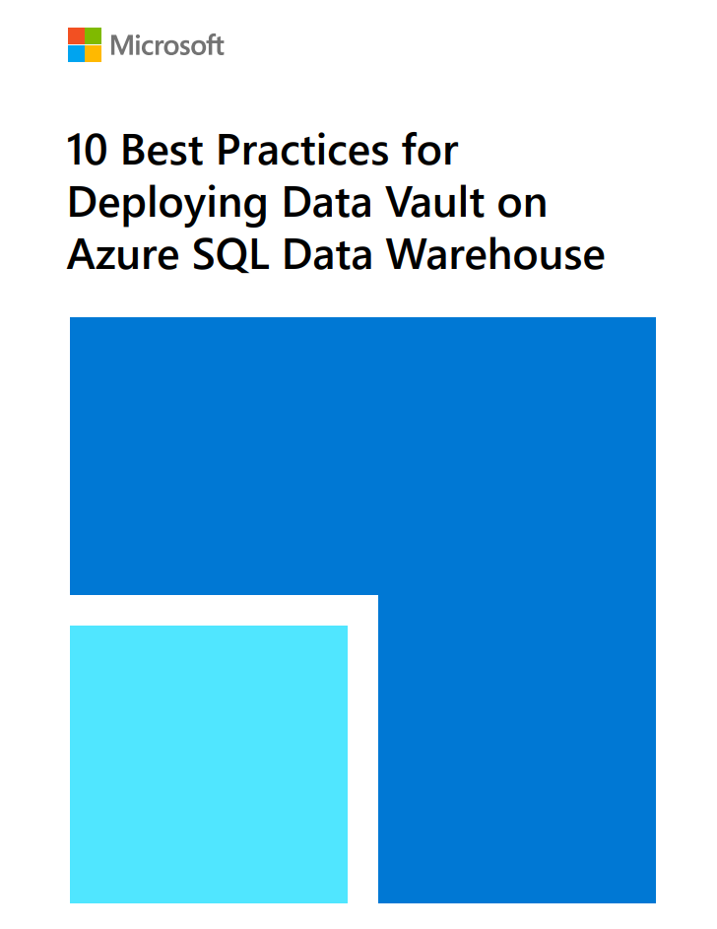
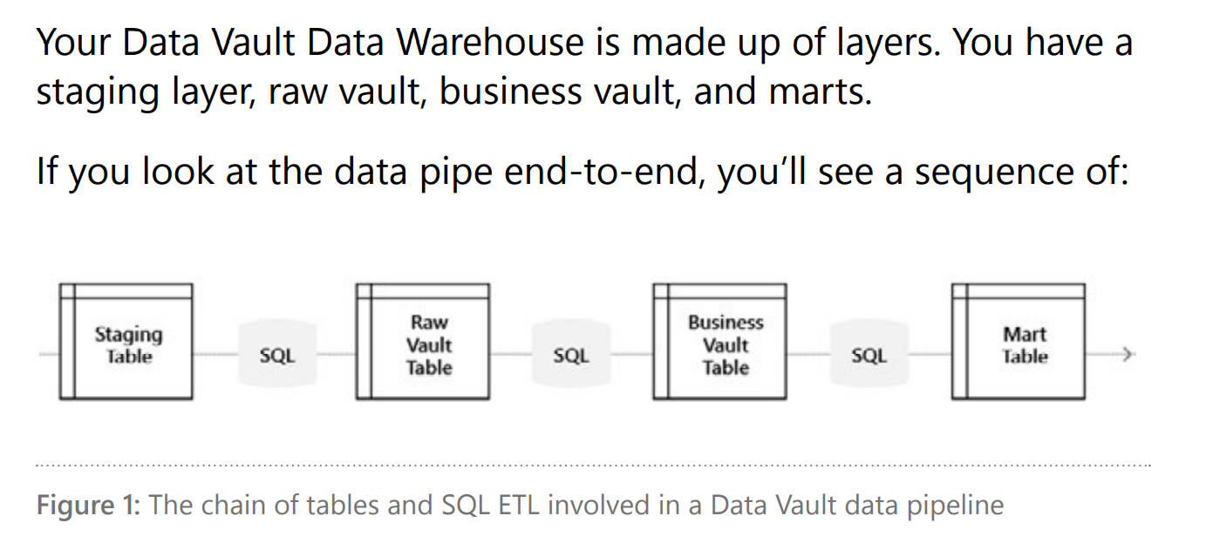
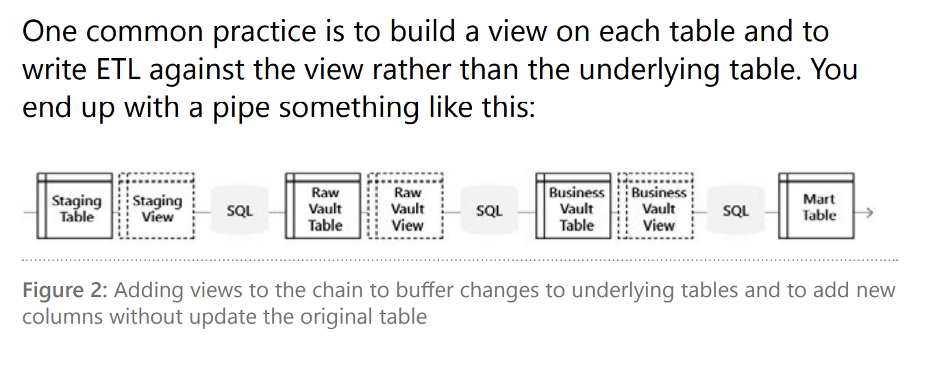
Data Vault DWH in Azure

Slide 41
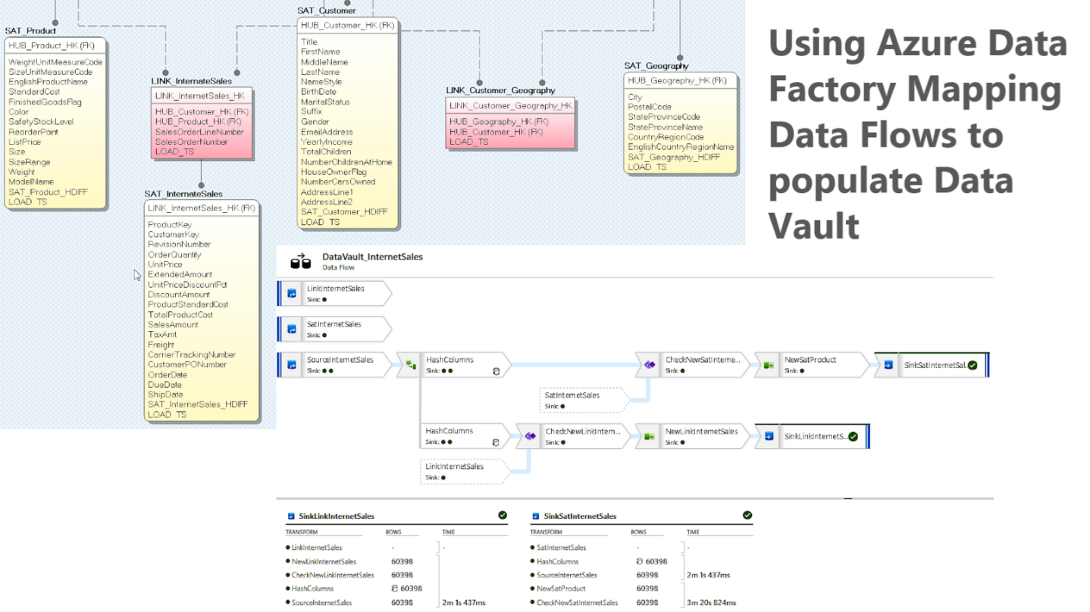
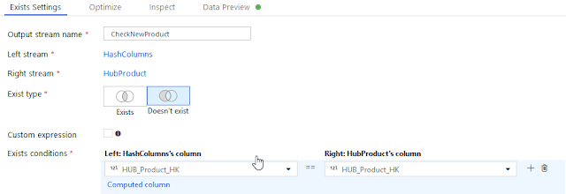
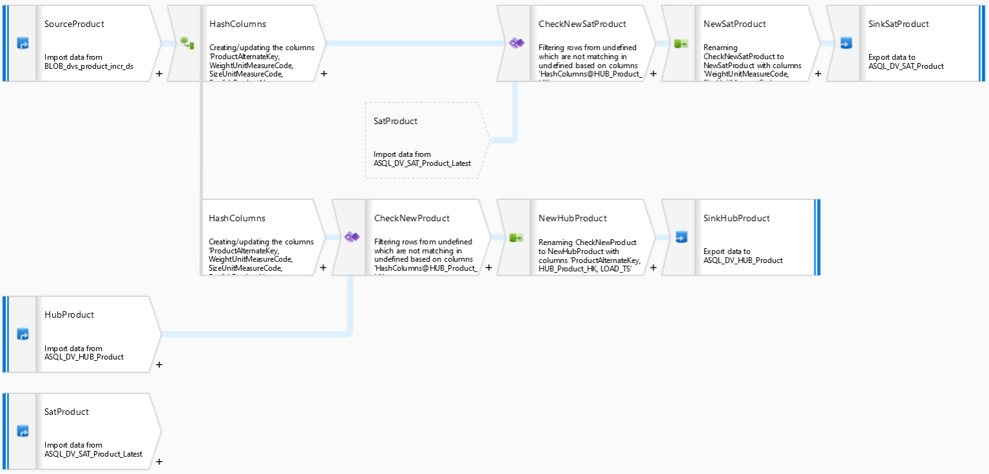
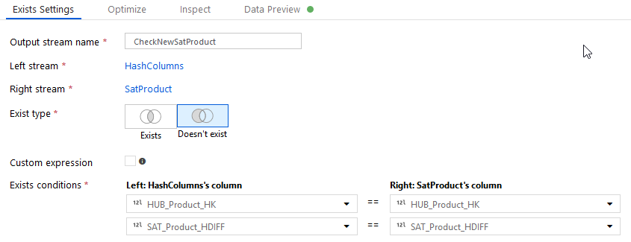
Data Vault DWH in Azure
https://github.com/NrgFly/Azure-DataFactory/tree/master/Samples
https://www.sqlservercentral.com/blogs/using-azure-data-factory-mapping-data-flows-to-populate-data-vault

Slide 42
SQL Pool (ex-SQL Data Warehouse)
Massively Parallel Processing (MPP)
Shared nothing architecture
One Control Node
Multiple Compute Nodes (scalability)
Data Movement Service
SQL Data Warehouse Gen2
Optimized for performance
NVMe storage for compute nodes
Can pause/resume and scale
Cost optimization
Offline operations, take some time (minutes), and happen to fail (scale)
Control
Cores
Memory
NVMe SSD
Compute
Cores
Memory
Cores
Memory
Cores
Memory
NVMe SSD
NVMe SSD
NVMe SSD
Remote Storage
Snapshot backups
Data
Log

Slide 43
SQL Pool Table Distribution – Round-Robin
CREATE TABLE [build].[FactOnlineSales]
(
[OnlineSalesKey] int NOT NULL
, [DateKey] datetime NOT NULL
, [StoreKey] int NOT NULL
, [ProductKey] int NOT NULL
, [PromotionKey] int NOT NULL
, [CurrencyKey] int NOT NULL
, [CustomerKey] int NOT NULL
, [SalesOrderNumber] nvarchar(20) NOT NULL
, [SalesOrderLineNumber] int NULL
, [SalesQuantity] int NOT NULL
, [SalesAmount] money NOT NULL
)
WITH
( CLUSTERED COLUMNSTORE INDEX
, DISTRIBUTION = ROUND_ROBIN
);
Default distribution
Use if:
There is no obvious joining key
There is no good candidate column for hash distributing the table
The table does not share a common join key with other tables
The join is less significant than other joins in the query
The table is a temporary staging table

Slide 44
SQL Pool Table Distribution – Hash
CREATE TABLE [build].[FactOnlineSales]
(
[OnlineSalesKey] int NOT NULL
, [DateKey] datetime NOT NULL
, [StoreKey] int NOT NULL
, [ProductKey] int NOT NULL
, [PromotionKey] int NOT NULL
, [CurrencyKey] int NOT NULL
, [CustomerKey] int NOT NULL
, [SalesOrderNumber] nvarchar(20) NOT NULL
, [SalesOrderLineNumber] int NULL
, [SalesQuantity] int NOT NULL
, [SalesAmount] money NOT NULL
)
WITH
( CLUSTERED COLUMNSTORE INDEX
, DISTRIBUTION = HASH([ProductKey])
);
Works well for large fact tables
Can provide high performance
Choosing distribution column is crucial
Only one column can be chosen
Consider if:
The table size on disk is 2GB+
The table has frequent insert, update, and delete operations

Slide 45
SQL Pool Table Distribution – Replicate
Minimized data movement
Consider if:
Table size on disk is <2GB
Table is used in joins that would require extensive data movement
Pausing/scaling of DWU occurs rarely
CREATE TABLE [dbo].[DimSalesTerritory_REPLICATE]
WITH
(
CLUSTERED COLUMNSTORE INDEX,
DISTRIBUTION = REPLICATE
)
AS SELECT * FROM [dbo].[DimSalesTerritory]
OPTION (LABEL = 'CTAS : DimSalesTerritory_REPLICATE’) ;
-- Switch table names
RENAME OBJECT [dbo].[DimSalesTerritory] TO [DimSalesTerritory_old];
RENAME OBJECT [dbo].[DimSalesTerritory_REPLICATE] TO [DimSalesTerritory];
DROP TABLE [dbo].[DimSalesTerritory_old];

Slide 46
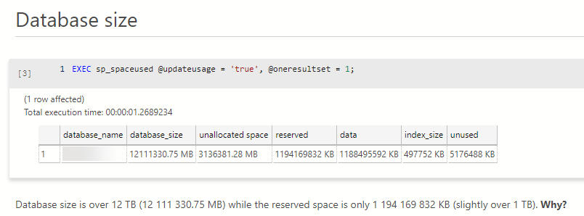
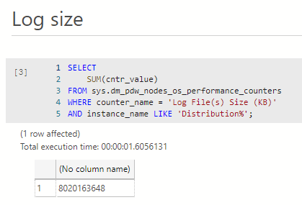
Storage CAN Cost Money in SQL Pools

Slide 47
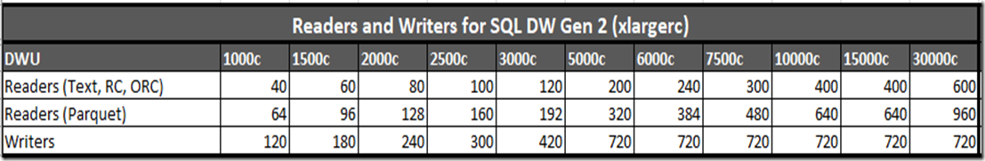
SQL Pool – Performance Levels
ALTER DATABASE ContosoRetailDW
MODIFY (service_objective = 'DW1000c');
Data Warehouse Units (DWUs)
CPU, memory and IO
DWUs’ impact on performance and scale
Large scans with aggregations
Data ingestion from data lake
CTAS operations
Concurrent queries
Always 60 distributions of data
Linear scale-out with more nodes
Linear memory scalability
Distributions per node
Tempdb max size - 399 GB per DW100c
https://docs.microsoft.com/en-us/azure/synapse-analytics/sql-data-warehouse/memory-concurrency-limits

Slide 48
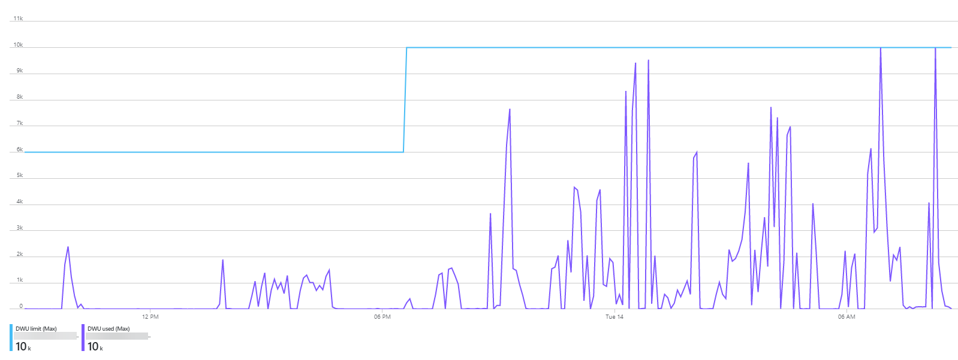
DWU Reality

Slide 49
SQL Pool - Concurrency Limits
Suggested service levels for SQL Pool involved in interactive queries.
https://docs.microsoft.com/en-us/azure/sql-data-warehouse/memory-concurrency-limits

Slide 50
SQL Pool – Tips for Load and Query Optimization
Use Polybase with its best practices to load and export the data
When defining paths in data lake point to the „highest” path possible
Prefer heaps with round-robin distribution for staging
Consider hash distribution when staging data for large hashed production tables
Use batches between 102,400 and 1,048,576 rows to load compressed rowgroups into columnstore
Use 60+ files to maximize throughput for parallel loads of GZIP files or compressed columnar/block files
Use CTAS to perform loads from External Tables to staging
Note: CTAS requires CONTROL permission of the database
Tip: use DENY CONTROL per schema if necessary
Use COPY statement to avoid CONTROL permissions
When performing transformations and quality checks with T-SQL, first create permanent tables using CTAS
Do not rely on queries to EXTERNAL TABLE
Think „CTAS first” when working with data in SQL Pool
Often works best even if you write more data as a result
Maintain statistics (link)
Create them for all columns in all tables after the first load or signifficant changes
Optimize transactions using minimally logged operations (link)
CTAS, INSERT..SELECT
CREATE/ALTER...REBUILD/DROP INDEX
DROP/TRUNCATE TABLE
ALTER TABLE SWITCH PARTITION
Optimize queries
Use the smallest possible data types to in DWH tables
Materialized views (link)
Result set caching (link)
Ordered clustered columnstore indexes (link)
Use DMVs for monitoring (link)
Use additional layer for serving Data Marts
Power BI, Azure Analysis Services, Azure SQL Database
Use Microsoft Toolkit for SQL Data Warehouse (link)
Note: some operations do not count towards the concurrency limits - DDL, INSERT VALUES, SELECT from DMVs, DBCC, EXPLAIN (link)

Slide 51
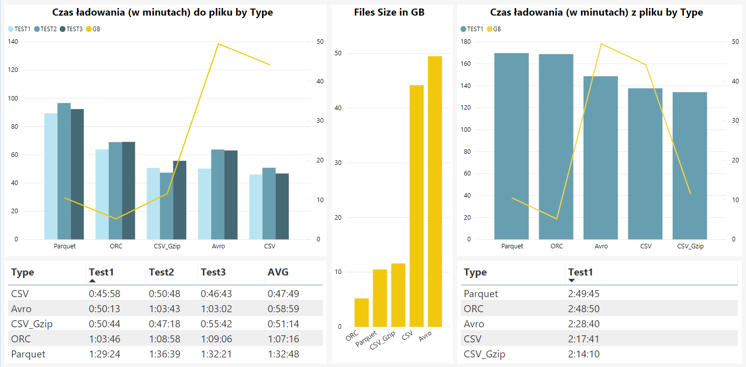
File Formats - a History of One Benchmark
Extract Time (minutes) by File Type
Load Time (minutes) by File Type

Slide 52
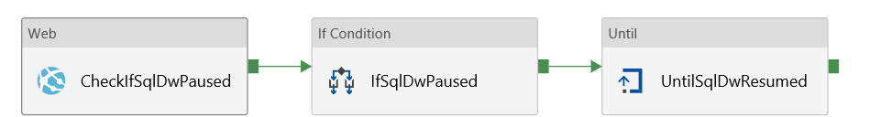
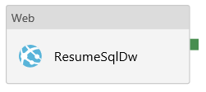
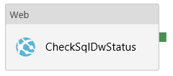
SQL Pool Automation
Scale, pause and resume
T-SQL (link for scaling)
PowerShell (link for scaling, link for pausing)
Automation (link)
Functions (link)
Orchestrate with Azure Data Factory
Use Web activity
Check for running queries first
Check status before and after (be prepared for unexpected situations)
True Activities

Slide 53
Demo
Azure Synapse Analytics – SQL Pool

Slide 54

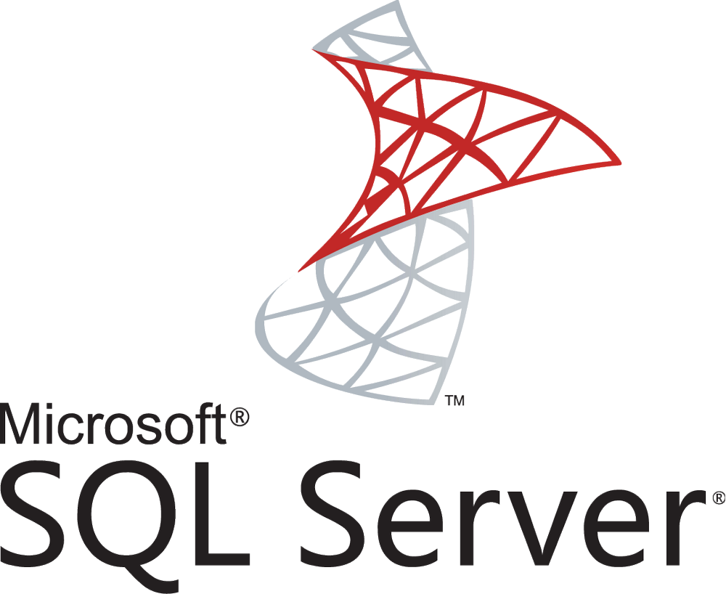
SQL Pool is NOT Your SQL Server
No recursive CTE (link)
No global temporary tables (link)
No cursors (link)
Nesting stored procedures is limited to 8 (not 32 like in SQL Server)
Limited transaction levels and size (link)
MERGE, UPDATE, DELETE mostly for compatibility, poor performance (link)
Use CTAS & partition switching (link)
One database, no cross-database operations
Official support list: link
PRIMARY KEYs not enforced
UNIQUE keys not enforced
No FOREIGN KEYs
Data Skew (due to data distribution)

Slide 55
Choose Synapse (SQL Pool) If...
...building a single tenant data warehouse
...using a well-formed dimensional model
...you intend to scale processing power
...you are OK with PaaS
...your database is 1TB+
...you have some flexibility in RPO & RTO
...you are OK with ELT approach
...you have skills to manage MPP
...you have to handle a limited number of concurrent queries
...you can wait for some coming features (multi-master clusters)

Slide 56

Azure Synapse Analytics (Public Preview)
Artificial Intelligence / Machine Learning / Internet of Things
Intelligent Apps / Business Intelligence
Designed for analytics workloads at any scale
Synapse Analytics
SaaS developer experiences for code free and code first
Experience
Synapse Studio
Platform
Multiple languages suited to different analytics workloads
MANAGEMENT
Languages
T-SQL
Spark SQL
Python
C#
Scala
Integrated analytics runtimes available provisioned and serverless built-in (on-demand)
SQL Analytics offering T-SQL for batch, streaming and interactive processing
Spark for big data processing with Spark SQL, Python, Scala and C#
SECURITY
Form Factors
DEDICATED
BUILT-IN (SERVERLESS)
MONITORING
Analytics Runtimes
SQL
METASTORE
DATA INTEGRATION
Integrated platform services for, management, security, monitoring, and metastore
Azure
Data Lake Storage
Common Data Model
Enterprise Security
Optimized for Analytics
Data lake integrated and Common Data Model aware

Slide 57
Demo
Azure Synapse Analytics Workspace

Slide 58
Azure Synapse Analytics Pros & Cons
PROS
CONS
Unified platform for Big Data and Data Warehousing
Three different engines for analytics
Integration with Power BI (more to come - automatically created materialized views)
Some level of similarity to SQL Server
Strategic service for analytics in Azure (big investment from Microsoft)
Connection links (Data Lake, Cosmos DB)
Gen3 in development (lots of features in private or public preview)
Unclear roadmap (timeline) - some of the most awaited capabilities may show up in H1 CY21
Workload management, schema design, and performance optimization require a lot of effort
Issues around pausing/resuming and scaling of SQL pools (failing, offline)

Slide 59
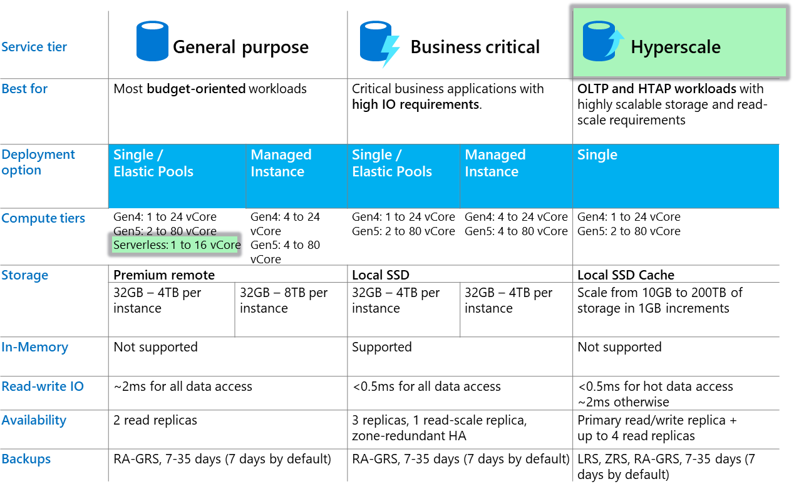
Azure SQL Database Options
NO POLYBASE

Slide 60
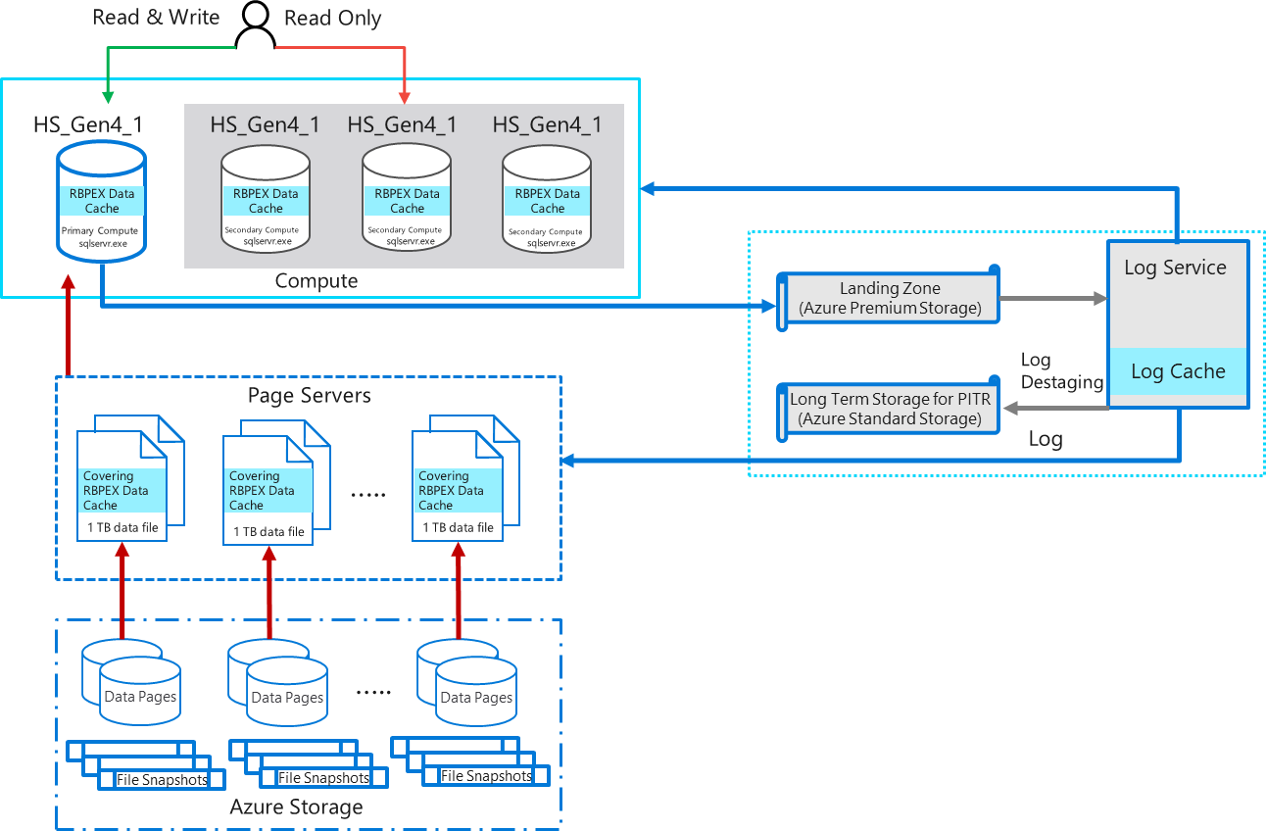
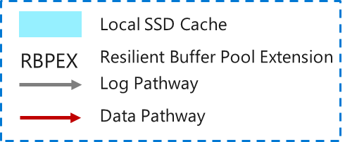
Azure SQL Database Hyperscale

Slide 61
Snowflake
Transactions
Security
Management
Ad hoc analytics
Service
Compute
Centralized storage
Storage
Development
Loading
Metadata
Optimization
Multi-cluster, shared data architecture

Slide 62

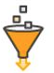








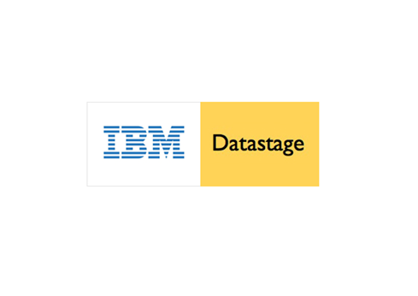
















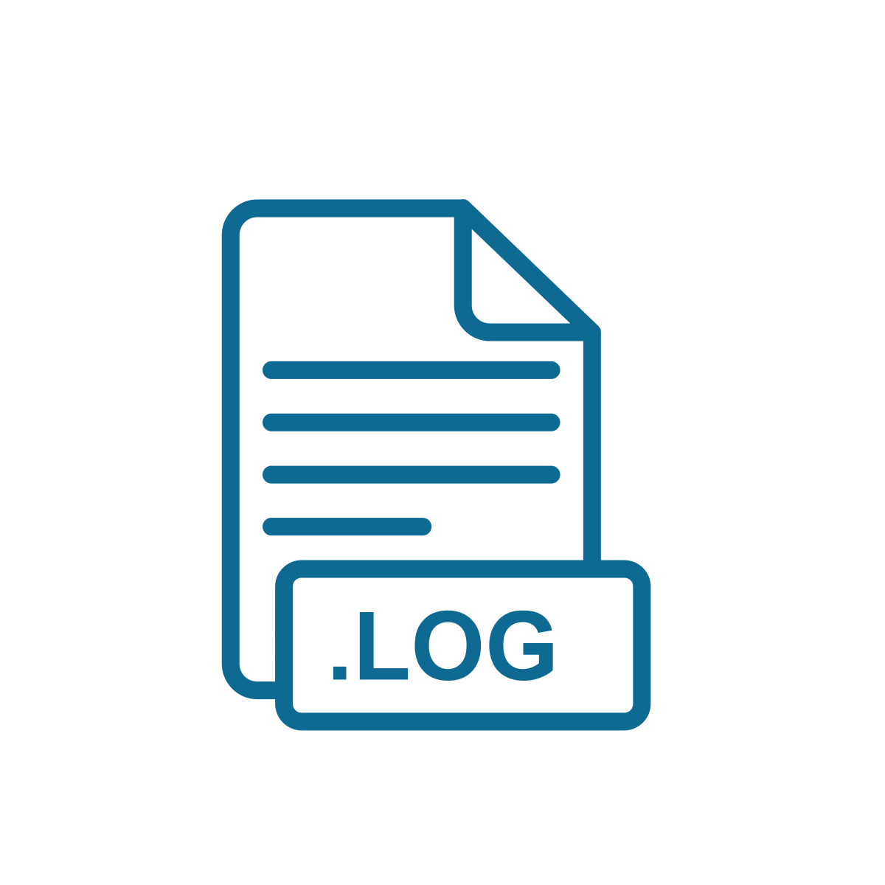













AWS Glue
L
AWS QuickSight
ETL/ELT
Sales
XS
M
Snowpipe
S
S
Global Services
Data Science
Logical Model
Security
Query Planning & Optimisation
M
Transactional Control

Slide 63
AWS Glue
AWS QuickSight
ETL/ELT
Sales
XS
M
…
M
Multi-cluster
Snowpipe
XL
S
Global Services
Data Science
Logical Model
Security
Query Planning & Optimisation
Transactional Control

Slide 64




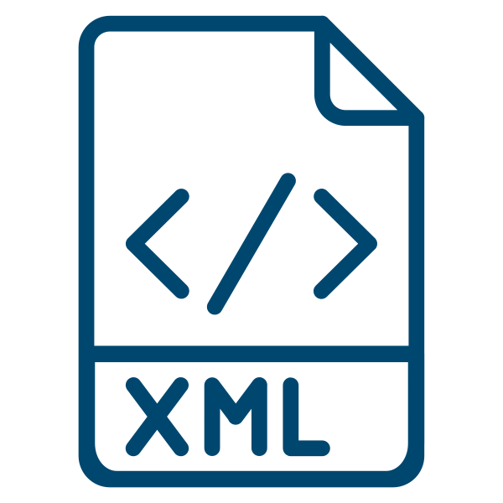


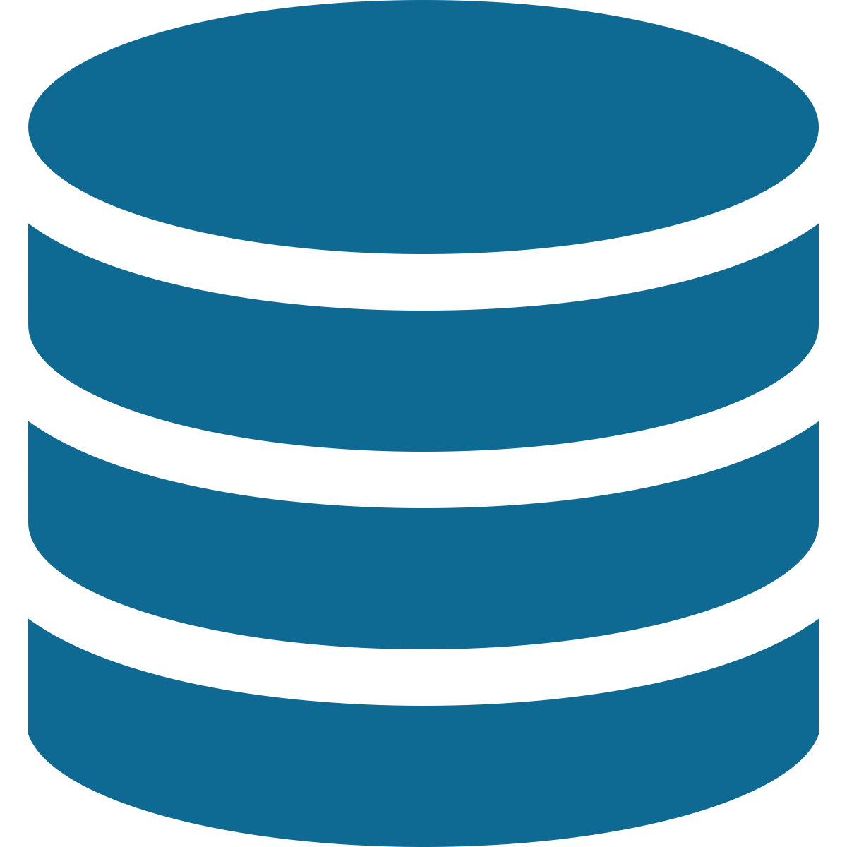
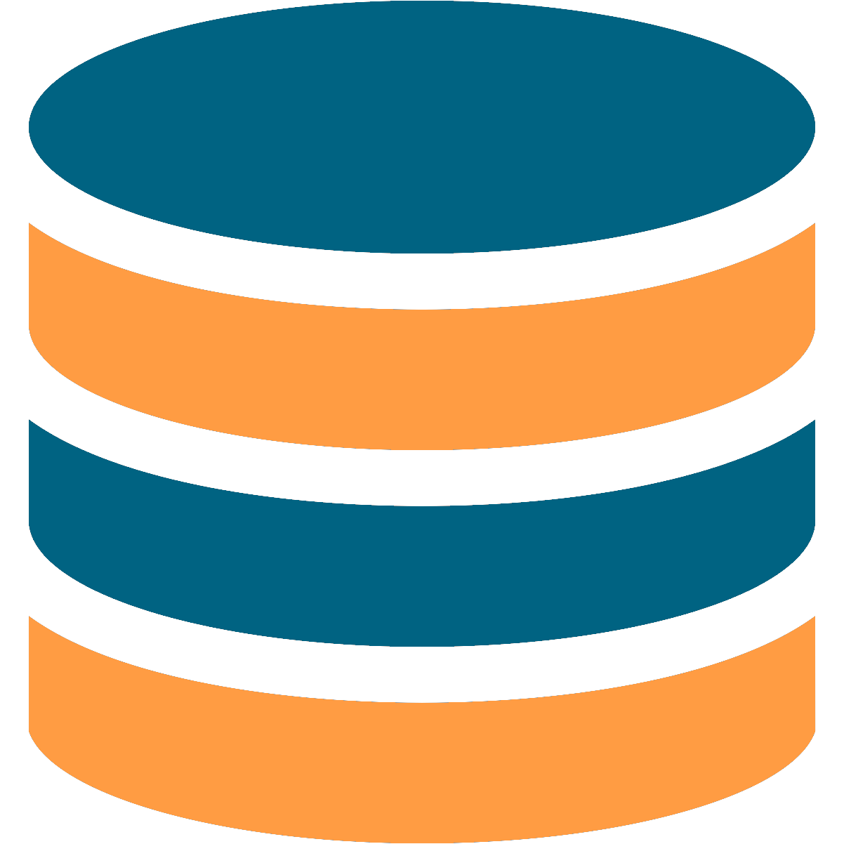

AWS Glue
External
AWS QuickSight
M
ETL/ELT
Sales
XS
Data Sharing
M
…
M
Multi-cluster
Snowpipe
Structured & semi-structured
Clone
S
XL
XL
Data protection & time travel
Global Services
Dev Ops
Data Science
Logical Model
Security
Query Planning & Optimisation
L
Transactional Control
Finance/DBAs

Slide 65

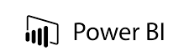

Snowflake Integration with Azure
ETL/ELT
Business Intelligence
XS
M
STAGE
Azure Storage Account
IDENTITY, AUTHENTICATION, SSO
Azure Active Directory
ORCHESTRATION
Azure Data Factory
Snowpipe
REAL-TIME
Azure Storage Account
Azure Service Bus
S
Global Services
Data Science
Logical Model
SECURITY
Azure Key Vault
Security
Query Planning & Optimisation
Transactional Control

Slide 66
Demo
Snowflake on Azure

Slide 67
Snowflake Pros & Cons
PROS
CONS
Modern DWH architecture (separation of layers – storage, compute, metadata)
Near-zero management (micro-partitioning)
Scalability (up & out)
Custom “intelligent” staging engine
Supported by a number of specialized ETL/ELT tools
FiveTran, Matillion, dbt, WhereScape
Problems around Power BI connector
Role property missing
Extensive metadata queries
Limited availability in Azure regions (Europe limited to WE region)
Just released connector in ADF
No table auto-creation
Temporary stages
No CI/CD in native WebUI

Slide 68

Network Access Security for Databases in Azure
Allow access to Azure services
VMVNET-EUS
VNET Peering
No access to Internet
US EAST
SQLDBVNET-EUS
US EAST
Firewall Rules
Azure VM
127.33.201.5
10.0.0.3
VMVNET-WUS
Azure VM
10.0.0.2
US WEST
174.17.218.16
10.0.0.5
Virtual Network Rules
mysqldbsrv.database. windows.net
Private Endpoint
westus1-a.control.
database.windows.net
104.42.238.205
mysqldbsrv.privatelink.
database.windows.net
10.0.0.5
Azure VM
10.0.0.1
102.14.157.9
Private Link
VNET Gateway
VNET Gateway
Vnet2Vnet
P2S, S2S VPN Express Route
On-premises

Slide 69

Data Ingestion & Transformations

Slide 70


Data Ingestion in Azure
Data Factory
PolyBase
SSIS
Databricks
Heterogenous
File based
Heterogenous
Heterogenous

Slide 71
Azure Data Factory (ADF)
Serverless, scalable, hybrid data integration service
Data movement and transformation at scale
Hybrid pipeline model
Author and monitor
SSIS package execution
Cloud and hybrid w/ 80+ connectors
Up to 2 GB/s ETL/ELT in the cloud
Seamlessly span on-prem, Azure, other clouds, SaaS
Run on-demand, scheduled, or on-event data-availability
Programmability with multi-language SDK
Visual tools
Lift existing SQL Server ETL to Azure
Use existing tools (SSMS, SSDT)

Slide 72



ADF Integration Runtime
UX & SDK Authoring | Monitoring/Management
ADF’s execution engine
Data movement
Pipeline activity execution
SSIS package execution
Azure Data Factory v2 Service Scheduling | Orchestration | Monitoring
Pipeline
SSIS package
Self-hosted
Integration runtime
Azure
Integration runtime
LEGEND
On-prem
Apps & data
Cloud services Apps & Data
Command and control
Data

Slide 73
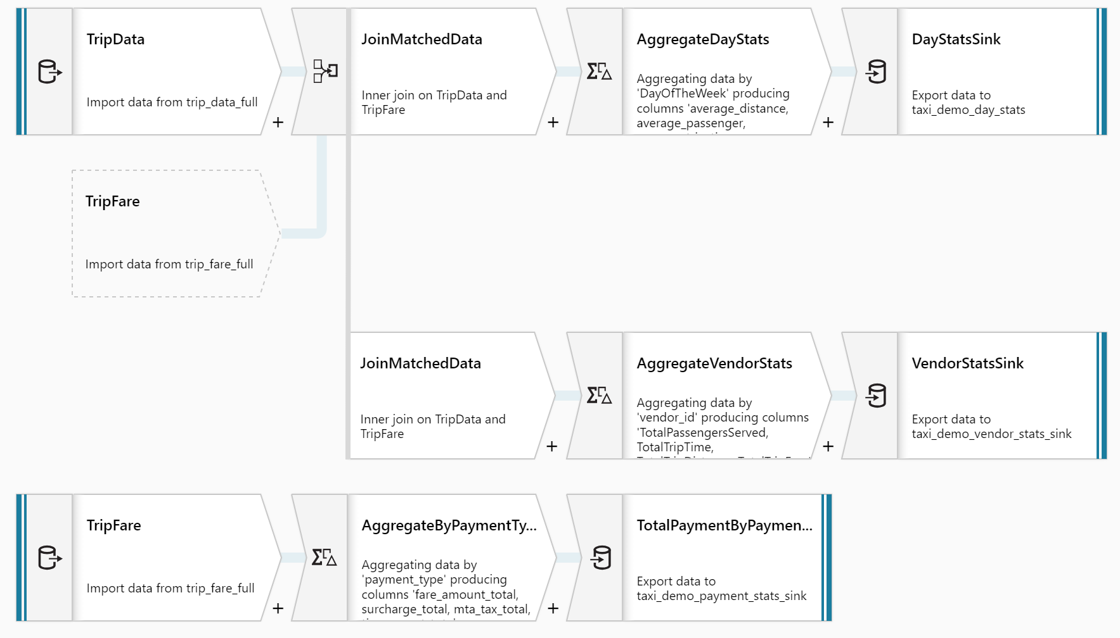
ADF Mapping Data Flows
Low Code approach
Data cleansing, transformation, aggregation, conversion, etc.
Spark (or Databricks) execution
Similar to SSIS transformations

Slide 74
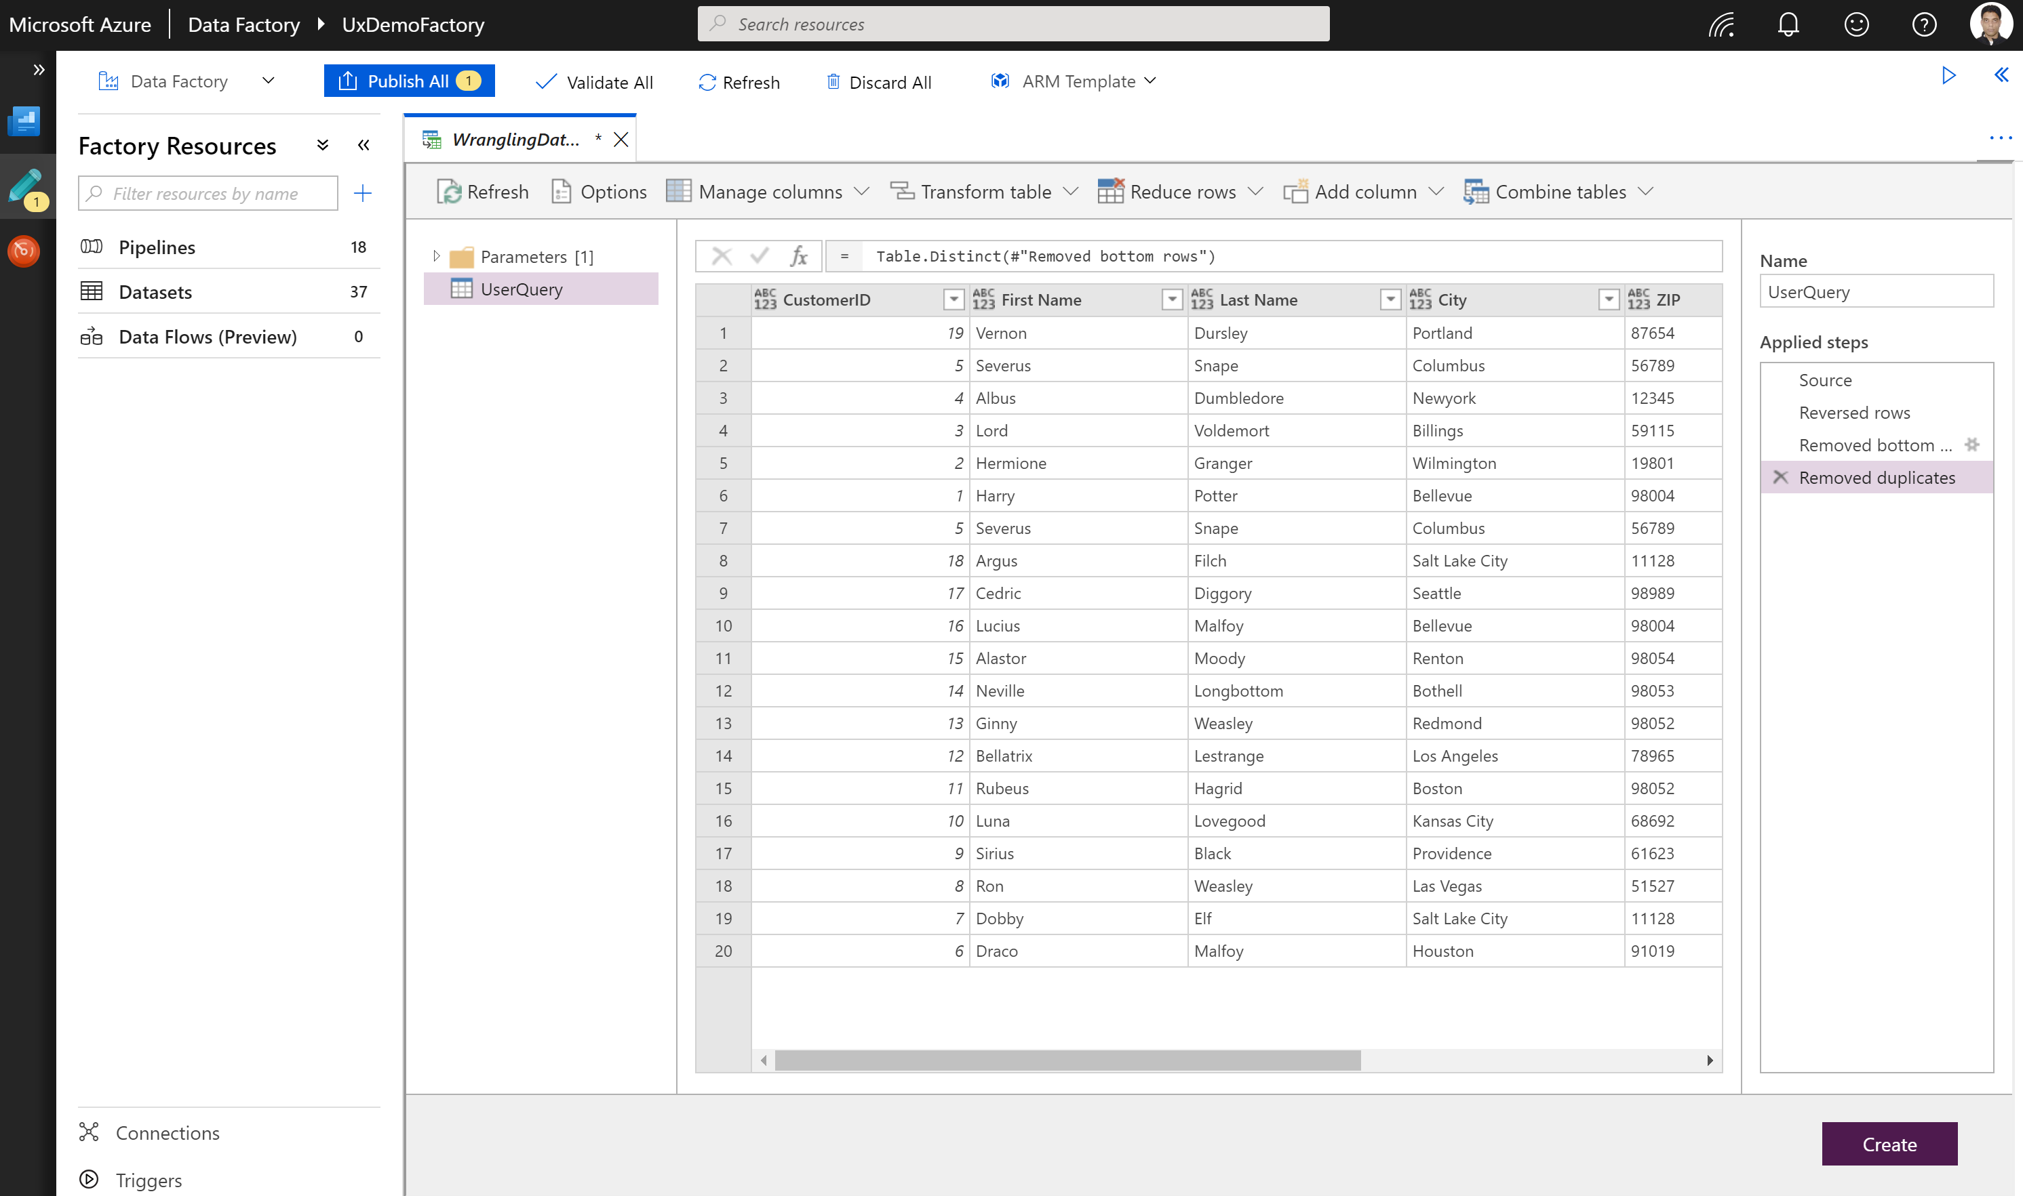
ADF Wrangling Dataflow ^{PREVIEW}
Code-free (or use M)
Power Query in Azure
Limited M functions support
Self-service data exploration and preparation
Limited data sources
Storage in Azure
SQL Database
Synapse

Slide 75
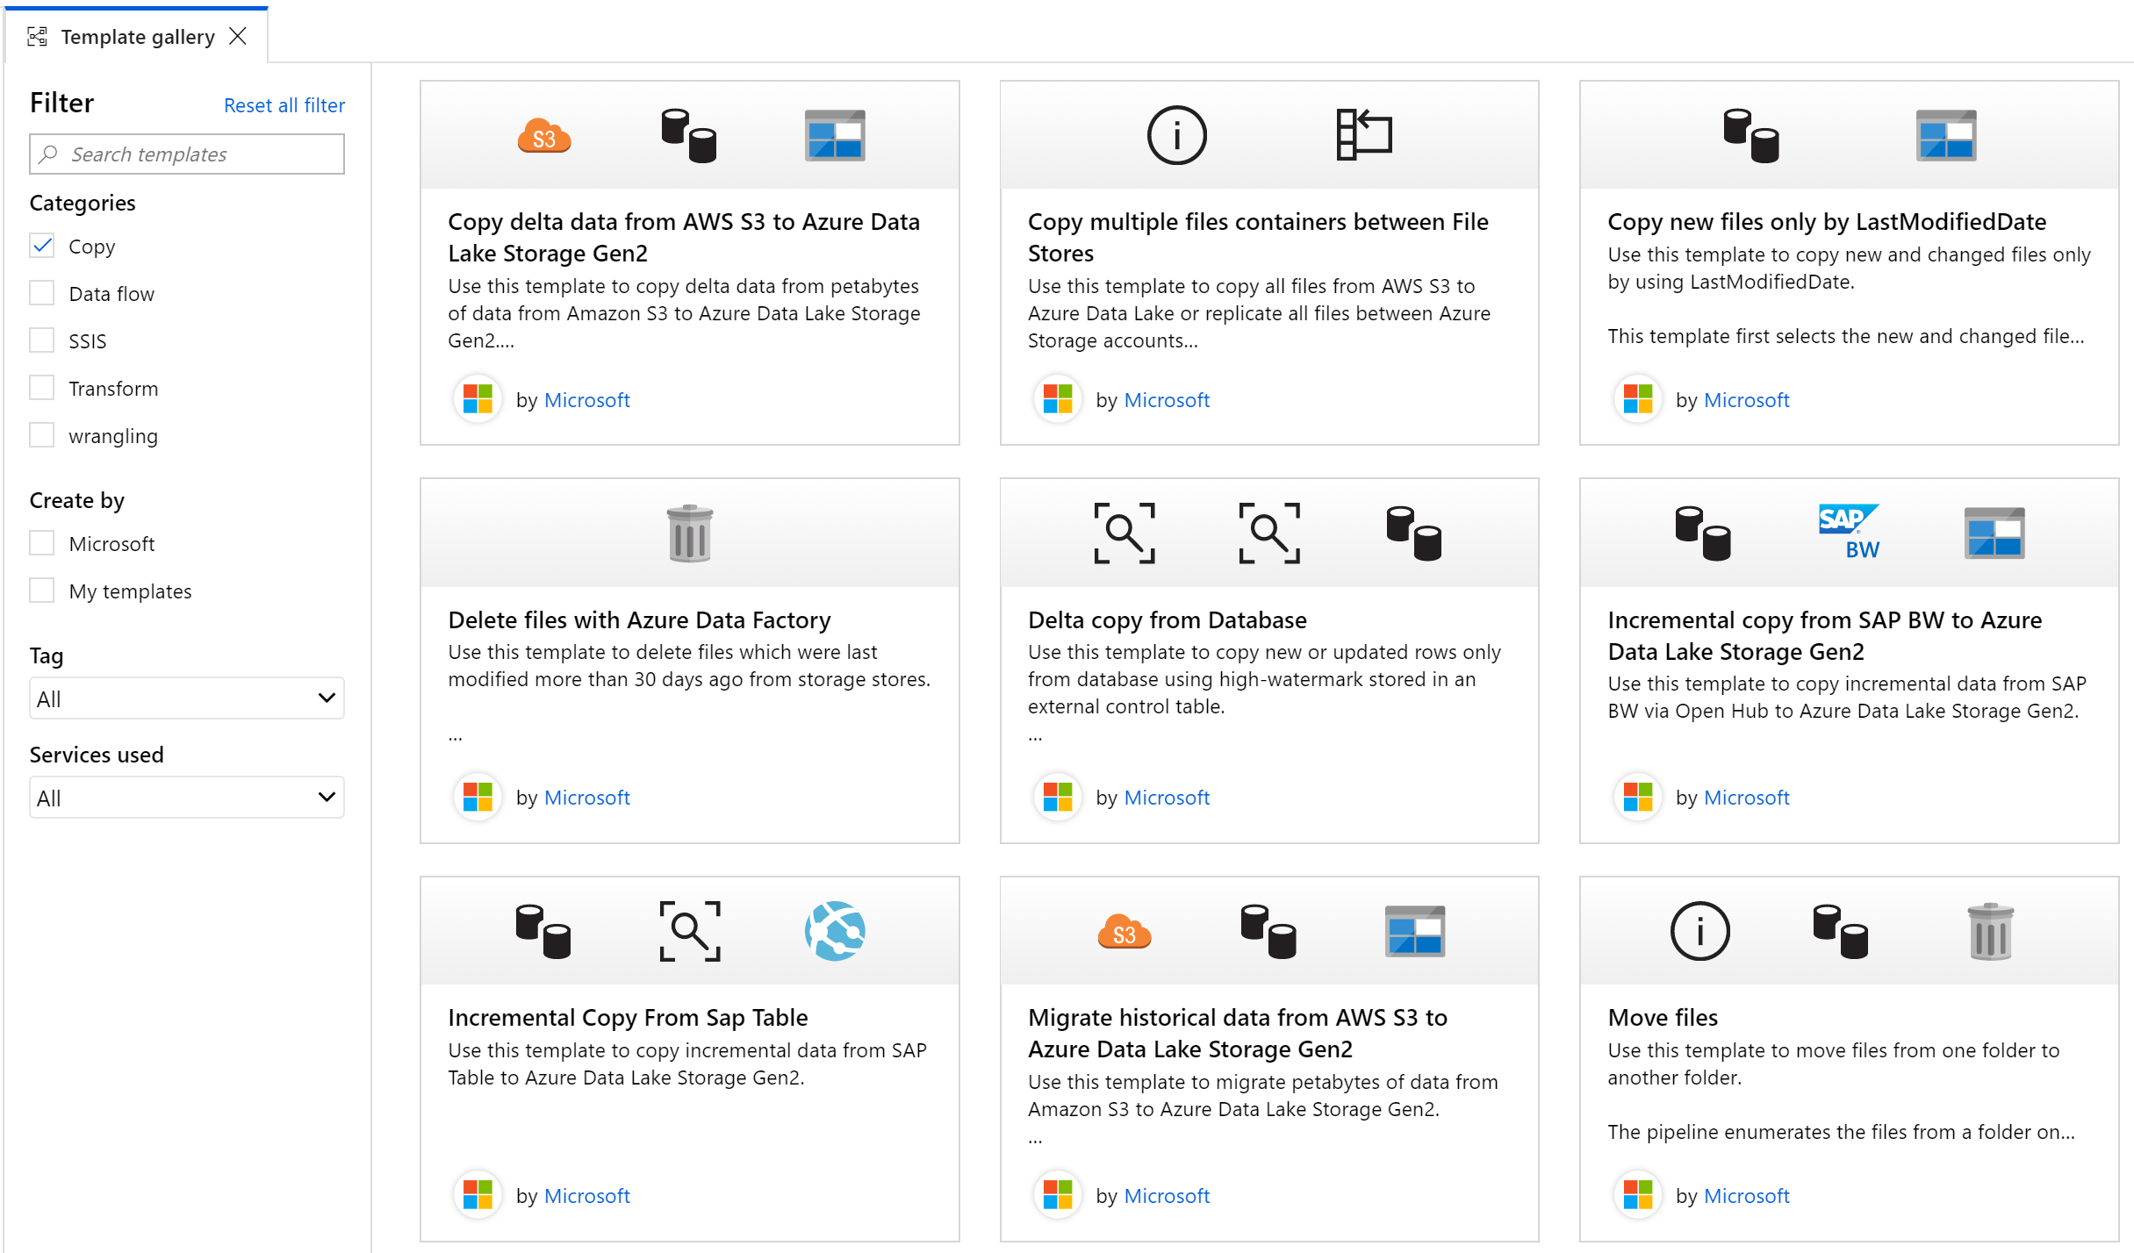
ADF Template Gallery

Slide 76
Demo
Data Ingestion and Transformation with ADF

Slide 77
Best Practices for ELT with ADF
Make pipelines as generic as possible (no hard coding)
Use metadata driven processing
Use dynamic content, variables and parameters
Make pipelines modular (usability over cost)
Create your own ADF templates for re-use
Audit data loads by collecting lineage, execution times, data volumes, and errors
Implement error handling for each important activity
Make sure the processing can be done in parallel
Keep your secrets in Azure KeyVault
Use User Properties and Annotations to make pipeline monitoring easier
Check if sink database (e.g. Synapse SQL Pool) is running and of the right scale before processing data
Consider using ADF framework (or create your own)
https://mrpaulandrew.github.io/procfwk/
Choose Polybase as preferred ELT mechanism for Synapse SQL Pool
Look out for traps – many options have to be set properly
The fact your pipeline runs does not mean it runs as fast as it can
Solve performance problems in data extraction from on-premises and the cloud
Scale self-hosted Integration-Runtime
Consider push approach (AzCopy, SSIS)
Provide adequate network bandwidth
SQL Databases and parallelism
Solution #1: raise number of DTUs/vCores
Solution #2: load by data shards and use parallel copying
Know the limits and expected throughput
https://docs.microsoft.com/en-us/azure/data-factory/copy-activity-performance

Slide 78
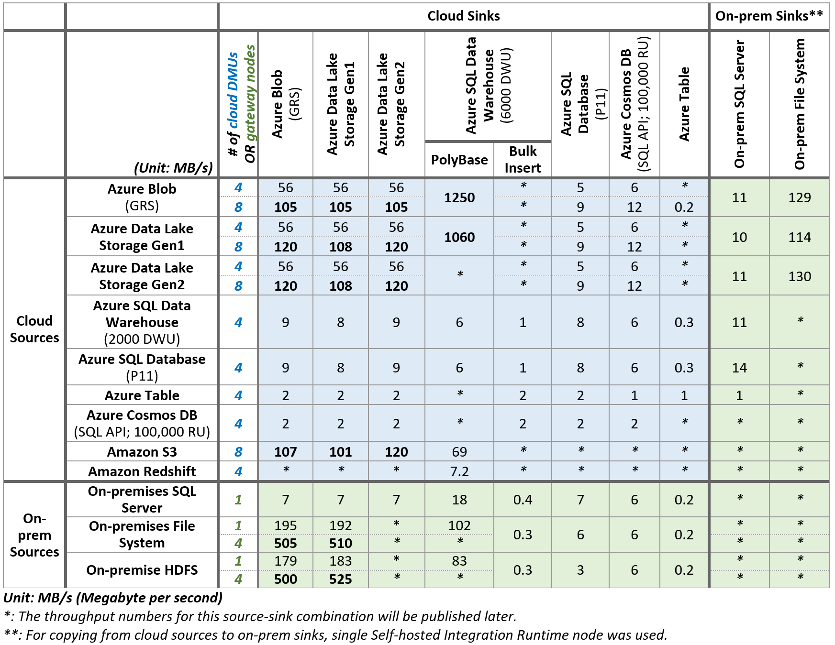
ADF Limitations
https://docs.microsoft.com/en-us/azure/data-factory/copy-activity-performance

Slide 79
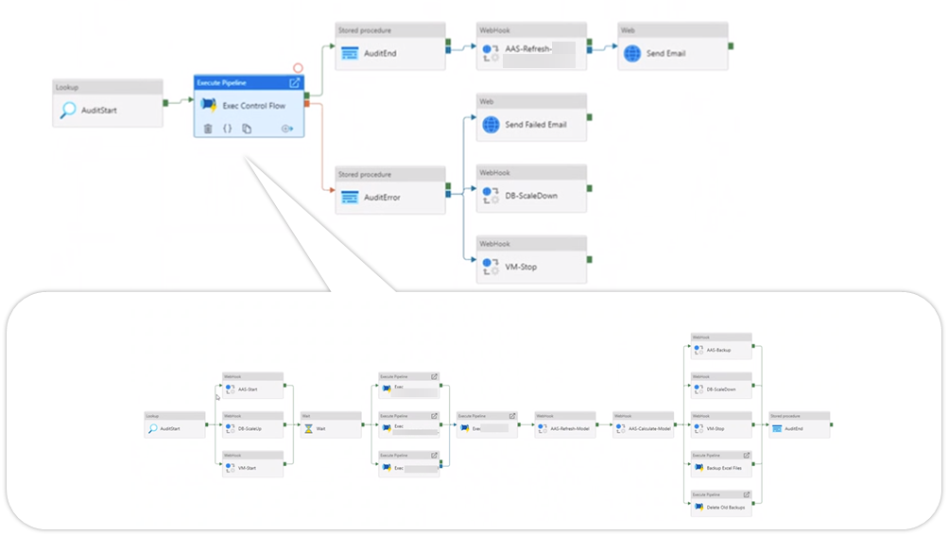
ADF Example

Slide 80
ADF Pros & Cons
PROS
CONS
Easy to start („few clicks”)
Fully managed by Azure
Pay-as-you-go
Integration with on-premises
Great for ELT pattern
Integration with SSIS (lift & shift)
Supports CI/CD
Has some innertion
Not for real-time data processing
Queuing happens
Limited or incomplete support for services of other cloud/SaaS vendors
Building complex pipelines can be tricky (e.g. AND logic everywhere)

Slide 81



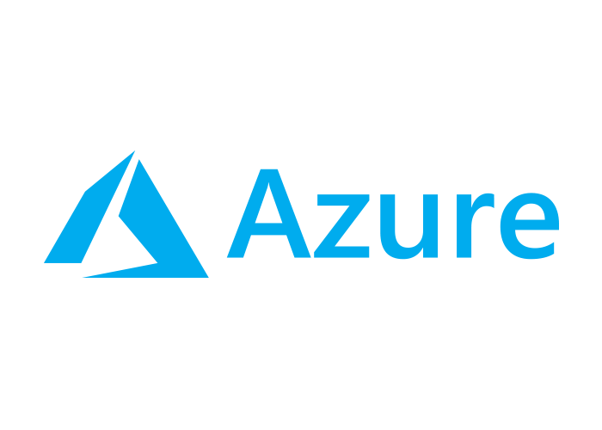
Azure Databricks
Azure Databricks
Collaborative Workspace (Notebooks)
IoT / streaming data
Machine learning models
DATA ENGINEER
DATA SCIENTIST
BUSINESS ANALYST
Deploy Production Jobs & Workflows
Cloud storage
BI tools
MULTI-STAGE PIPELINES
JOB SCHEDULER
NOTIFICATION & LOGS
Data warehouses
Optimized Databricks Runtime Engine
Data exports
Hadoop storage
DATABRICKS I/O
APACHE SPARK
SERVERLESS
Rest APIs
Data warehouses

Slide 82
Azure Databricks Pros & Cons
PROS
CONS
„Swiss Army knife” - can address multiple workloads
Analytics, ETL, ML, Spark streaming, graph analysis,… custom
Integrates well with other Azure services
Storages, Azure AD, SQL Database, Synapse Analytics, Key Vault, Machine Learning, Data Factory
Self-documented and integrated with CI/CD
Easily fits skills of Data Engineers (with 4 languages available in notebooks)
Delta Tables are great for many things
Incremental loads with append (upsert)
Historical data with Time Travel
Performance optimizations
No clear future as Microsoft brings their own Spark to Synapse Analytics
Some features cannot be used together
Example: high concurrency clusters and Scala
Example: table access control and credentials passthrough
Integration with ADF through generated tokens

Slide 83
Demo
Azure Databricks for Data Processing

Slide 84
Stream Processing & Real-Time Analytics in Azure
Real-time ingestion (link)
Event Hubs – simple service for device-to-cloud messaging (supports Kafka)
IoT Hubs – great for two-way communication with IoT devices
HDInsight (Kafka) – supports all Kafka’s features (e.g. Kafka Streams)
Stream processing (link)
Stream Analytics
HDInsight (Storm)
Kafka Streams API in HDInsight
Databricks
Azure Functions
App Service WebJobs
On-demand or interactive real-time analytics
Data Explorer - can ingest, store, and query large volumes of data
Operational store
Cosmos DB – NoSQL database with low latency
Analytical store in PREVIEW
Challenge – no DirectQuery in Power BI
Analyze with Synapse serverless engine (PREVIEW)
Questions:
What does „real-time” mean for the business process?
What kind of tools/app is used for accessing „real-time” data?
Are we talking about data streams or micro-batches?
What metrics matter the most (current values vs aggregations)?

Slide 85

Business Models & BI Tools

Slide 86
Architecture Pattern
LOB sources
Azure Data Factory
Business services
Azure Synapse Analytics
Logs and streams (unstructured)
Azure Databricks
Power BI
Media (unstructured)
Files (unstructured)
Azure Data Lake Storage

Slide 87
Business Models & BI Tools
LOB sources
Azure Data Factory
Business services
Azure Synapse Analytics
Logs and streams (unstructured)
Azure Databricks
Power BI
Media (unstructured)
Files (unstructured)
Azure Data Lake Storage

Slide 88

Azure Analysis Services
PaaS hosted and managed
Tabular mode only
Up to 400GB of memory (NOT model size!)
Tables can be partitioned
Partitions cannot have mixed modes (Import + DirectQuery)
No Composite Model (Import + DirectQuery)
Not on the roadmap
More and more covered by Power BI Premium
And Power BI Premium has faster development lifecycle!

Slide 89
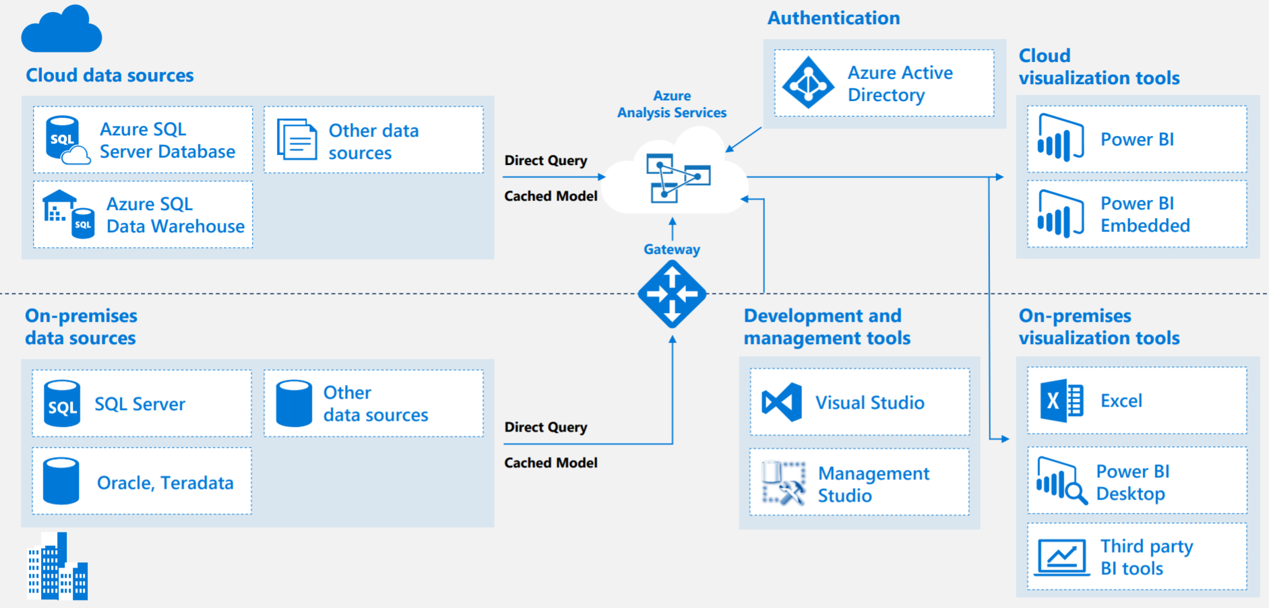
Azure Analysis Services Architecture

Slide 90


AAS Scalability Features
Scale-up
Scale-out
https://docs.microsoft.com/en-us/azure/analysis-services/analysis-services-overview#availability-by-region

Slide 91
AAS Scalability and Performance – Lessons Learned
Memory
400GB is not that much (and you need to pay for S9/S9V2!!!)
Keep your model narrow – cut unnecessary columns
Keep columns narrow (bigint IS EVIL!)
Prepare data marts in DWH
Monitor the size of your tables – Vertipaq Analyzer
Watch out for the cardinality limit (2B for a single column)
https://docs.microsoft.com/en-us/azure/analysis-services/analysis-services-capacity-limits
QPUs
It’s NOT about memory and model size only
It’s MORE about QPUs
https://prologika.com/notes-on-analysis-services-performance-and-parallelism/
https://prologika.com/notes-on-analysis-services-tabular-performance-and-parallelism-part-2/
Complex DAX can speed up QPUs depletion
Consider Tabular Editor instead of SSDT ☺

Slide 92
AAS Automation
Processing (Azure Functions)
https://azure.microsoft.com/es-es/blog/automating-azure-analysis-services-processing-with-azure-functions/
AAS Scheduled AutoScaling (Automation) by Jorg Klein
https://gallery.technet.microsoft.com/scriptcenter/Scale-and-Pause-or-Resume-54ce97a2
AAS Automation by Greg Galloway
https://github.com/furmangg/automating-azure-analysis-services
AAS Refresh with LogicApps by Adam Marczak
https://marczak.io/posts/2019/06/logic-apps-refresh-analysis-services/
https://marczak.io/posts/2019/06/logic-app-vs-data-factory-for-aas-refresh/

Slide 93

IaaS to the Rescue?
https://github.com/Azure/azure-arch-enterprise-bi-and-reporting

Slide 94

Power BI in a Nutshell

Slide 95

Power BI – Enterprise Deployment

Slide 96

Power BI – Centralized Reporting & Warehousing

Slide 97


Power BI Integration with Synapse
Today (or in Preview)
Future
Power BI
Aggregations
Composite models
Incremental Refresh
Azure Data Lake Storage Gen2 integration
DirectQuery for Q&A and AI visuals
Synapse
Materialized Views
Result set caching
Workload Management
Synapse Studio
Connectivity to SQL On-Demand
Synapse Link for Cosmos DB
Power BI
Enterprise Semantic Models (with R/W XMLA endpoints)
Live connect composite models
Large models in Power BI
Auto-creation of materialized views in Synapse based on Power BI queries
Synapse
Multi-master clusters in Synapse
Auto-scaling of SQL Pools
Online scaling of SQL Pools
Synapse Link for SQL Database
On-demand SQL queries on the most popular formats

Slide 98

Power BI – Self-Service Data Prep with Dataflows

Slide 99
Power BI – Best Practices
Power BI requires adoption - use Adoption Framework: https://github.com/pbiaf/powerbiadoption
Do NOT assume everything has to be in one big model
Do NOT overestimate Premium (but Gen2 looks great!)
It’s dedicated, but LIMITED capacity
It required planning and monitoring
Aggregations and composite models can do the thing
Just make sure they are used!
Look for DirectQuery over Power BI and AAS
For big datasets let the user start with limited portion of data
Filtering welcome page can be useful
Too many visuals one a report page will kill you
10 visuals on a single page can be too many!
Version your reports and datasets
Use Power BI templates (.pbit) with DevOps
Use R/W XMLA endpoints in Power BI Premium
Monitor usage
Not only for performance – licensing, cost optimization

Slide 100
Demo
Power BI in Modern Data Warehouse Architecture

Slide 101
Future State
LOB sources
Azure Data Factory
Business services
Azure Synapse Analytics
Logs and streams (unstructured)
Azure Databricks
Power BI
Media (unstructured)
Files (unstructured)
Azure Data Lake Storage

Slide 102
Future State
LOB sources
Azure Synapse Analytics
Power BI
Logs and streams (unstructured)
Media (unstructured)
Files (unstructured)
Azure Data Lake Storage

Slide 103

Advanced Analytics

Slide 104
Architecture Pattern
LOB sources
Azure Data Factory
Business services
Azure Synapse Analytics
Logs and streams (unstructured)
Azure Databricks
Power BI
Media (unstructured)
Files (unstructured)
Azure Data Lake Storage

Slide 105

Advanced Analytics
LOB sources
Azure Data Factory
Business services
Azure Synapse Analytics
Logs and streams (unstructured)
Azure Databricks
Azure Machine Learning
Power BI
Media (unstructured)
Files (unstructured)
Azure Data Lake Storage

Slide 106
The Microsoft AI Platform
Services
CONVERSATIONAL AI
TRAINED SERVICES
CUSTOM SERVICES
CODING & MANAGEMENT TOOLS
Bot Framework
Tools
Cognitive Services
Azure Machine Learning
VS Tools for AI
Azure ML Studio
Azure ML Workbench
Others (PyCharm, Jupyter Notebooks…)
Infrastructure
DEEP LEARNING FRAMEWORKS
AI ON DATA
AI COMPUTE
3rd Party
Cosmos DB
SQL
DB
SQL DW
Data Lake
Spark
DSVM
Batch AI
ACS
Edge
Cognitive Toolkit
TensorFlow
Caffe
CPU, GPU, FPGA+
Others (Scikit-learn, MXNet, Keras, Chainer, Gluon…)

Slide 107


Azure Machine Learning Service
Workflow Steps
Develop machine learning training scripts in Python.
Create and configure a compute target.
Submit the scripts to the configured compute target to run in that environment. During training, the compute target stores run records to a datastore. There the records are saved to an experiment.
Query the experiment for logged metrics from the current and past runs. If the metrics do not indicate a desired outcome, loop back to step 1 and iterate on your scripts.
Once a satisfactory run is found, register the persisted model in the model registry.
Develop a scoring script.
Create an Image and register it in the image registry.
Deploy the image as a web service in Azure.
Azure Machine Learning

Slide 108
Demo
Advanced Analytics in Synapse, Databricks and Azure ML

Slide 109

Summary

Slide 110
Architecture Pattern
LOB sources
Azure Data Factory
Business services
Azure Synapse Analytics
Logs and streams (unstructured)
Azure Databricks
Power BI
Media (unstructured)
Files (unstructured)
Azure Data Lake Storage

Slide 111









Architecture Pattern
LOB sources
Azure Data Factory
Azure Synapse Analytics
Business Intelligence Tools
Azure SQL Database
Logs and streams (unstructured)
Azure Databricks
Azure Event Hubs
Snowflake
Power BI
Media (unstructured)
Files (unstructured)
Azure Data Lake Storage

Slide 112



Continuous integration and delivery (CI/CD)
Overview
Database project support in SQL Server Data Tools (SSDT) allows teams of developers to collaborate over a version-controlled Azure Synapse Analytics, and track, deploy and test schema changes.
Benefits
Database project support includes first-class integration with Azure DevOps. This adds support for:
Azure Pipelines to run CI/CD workflows for any platform (Linux, macOS, and Windows)
Azure Repos to store project files in source control
Azure Test Plans to run automated check-in tests to verify schema updates and modifications
Growing ecosystem of third-party integrations that can be used to complement existing workflows (Timetracker, Microsoft Teams, Slack, Jenkins, etc.)

Slide 113


Slide 114
Azure Important Resources
Try Azure for free ($200): https://azure.microsoft.com/en-us/free/
Access free training at Pluralsight: https://www.pluralsight.com/partners/microsoft/azure
Services by region: https://azure.microsoft.com/en-us/global-infrastructure/services/
Service health status: https://status.azure.com/en-us/status
Service SLAs: https://azure.microsoft.com/en-us/support/legal/sla/
Azure updates: https://azure.microsoft.com/en-us/updates/
Pricing calculator: https://azure.microsoft.com/en-us/pricing/calculator/
Azure Charts: https://azurecharts.com/
Latency to Azure regions: http://azurespeedtest.azurewebsites.net/
Azure Well-Architected Framework: https://docs.microsoft.com/en-us/azure/architecture/framework/
Cloud Adoption Framework: https://docs.microsoft.com/en-us/azure/cloud-adoption-framework/

Slide 115
Azure Analytics Labs
Synapse + AI Lab: https://github.com/microsoft/MCW-Azure-Synapse-Analytics-and-AI
Cosmos DB + Synapse Real-Time Analytics Lab: https://github.com/microsoft/MCW-Cosmos-DB-Real-Time-Advanced-Analytics
IoT Hub + Stream Analytics + Databricks Analytics: https://github.com/microsoft/MCW-Internet-of-Things
Migrate EDW to Azure SQLDW (Synapse): https://github.com/microsoft/MCW-Migrate-EDW-to-Azure-SQL-Data-Warehouse

Slide 116

Watch Out for Upcoming News (December 3rd)!
Get guidance from industry leaders and customers on how to develop a strategic view of your analytics initiatives and create a framework for implementing successful solutions.
Be the first to learn about the new Azure data governance service and take an in-depth look at how it works together with Azure Synapse Analytics to provide a unified, end-to-end platform for data and analytics.
Follow demos to see how the native integration of Power BI and Azure Synapse Analytics accelerates time to insight and helps you enforce security and compliance requirements.
Ask questions and get expert answers during live Q&A.
https://azuredataandanalytics2020.eventcore.com/auth/login

Slide 117
Snowflake Resources
30-day Trial: https://trial.snowflake.com/
Hands-on Lab: https://s3.amazonaws.com/snowflake-workshop-lab/Snowflake_free_trial_LabGuide.pdf
Documentation: https://docs.snowflake.net/manuals/index.html
Snowflake on Azure series at Elitmind Academy: https://www.youtube.com/c/ElitmindAcademy/search?view_as=subscriber&query=snowflake

Slide 118

Hurtownie i analiza danych
Termin szkolenia: 14.XII – 1.II
7 tygodni nauki
7 spotkań online (czwartki, godz. 20:00)
9 modułów
Aktualizacje kursu bezpłatnie
Certyfikat ukończenia
Zapisy do 11 grudnia, godz. 20:00
14 dni na rezygnację i zwrot 100% wpłaty
Kod rabatowy o wartości 150zł: sqlday2020

Slide 119


Modern Data Warehouse in Azure Why, How, What
Paweł Potasiński pawel.potasinski@elitmind.com

